Slide 1
Integration of snRNA atlases of the adult human midbrain
By: Chen Ji Rong “Jack” Jiang
Supervisor: Onur Basak

Slide 2
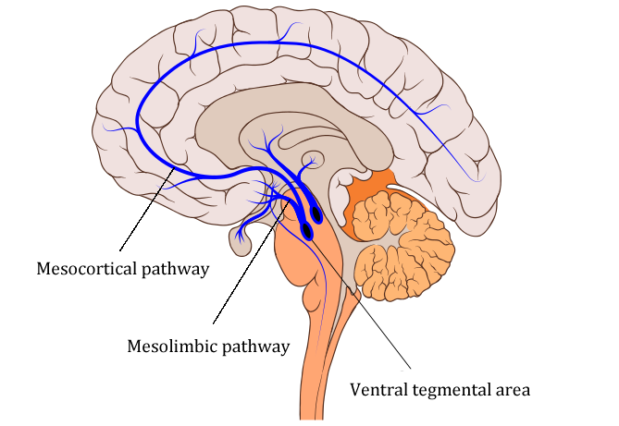
(Ventral) Midbrain
Role in:
Cognition
Reward system
Regulation of emotion, motivation and behavior
Associated with neurodegenerative diseases such as Parkinson’s Disease
Problem: High heterogenity, low sensitivity

Slide 3
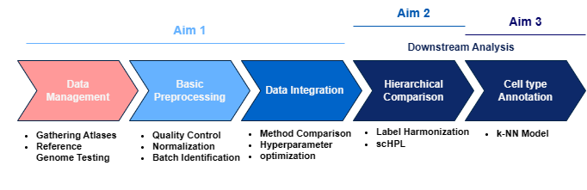
Aims
Integrate multiple atlases into one unified human (ventral) midbrain atlas
Determine hierarchical relations between previously identified cell types by the authors of the atlases
Determine (new) cell types and annotate them

Slide 4
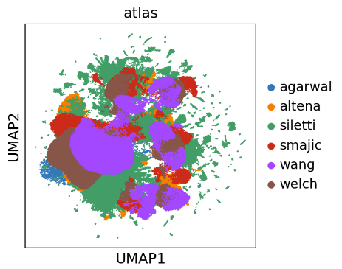
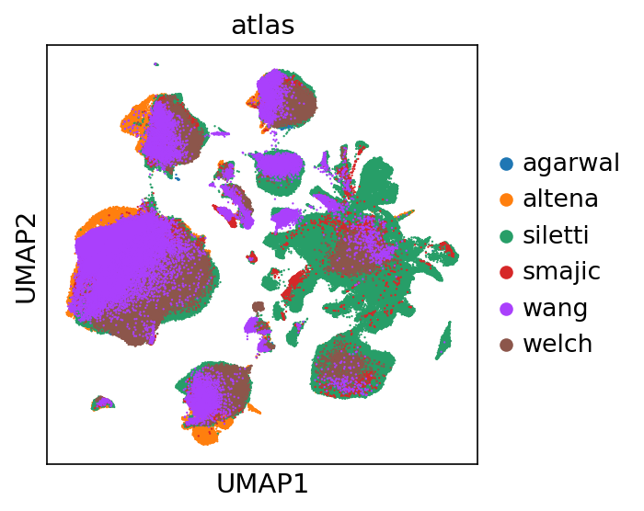
Spoilers

Slide 5

Spoilers
Integration

Slide 6
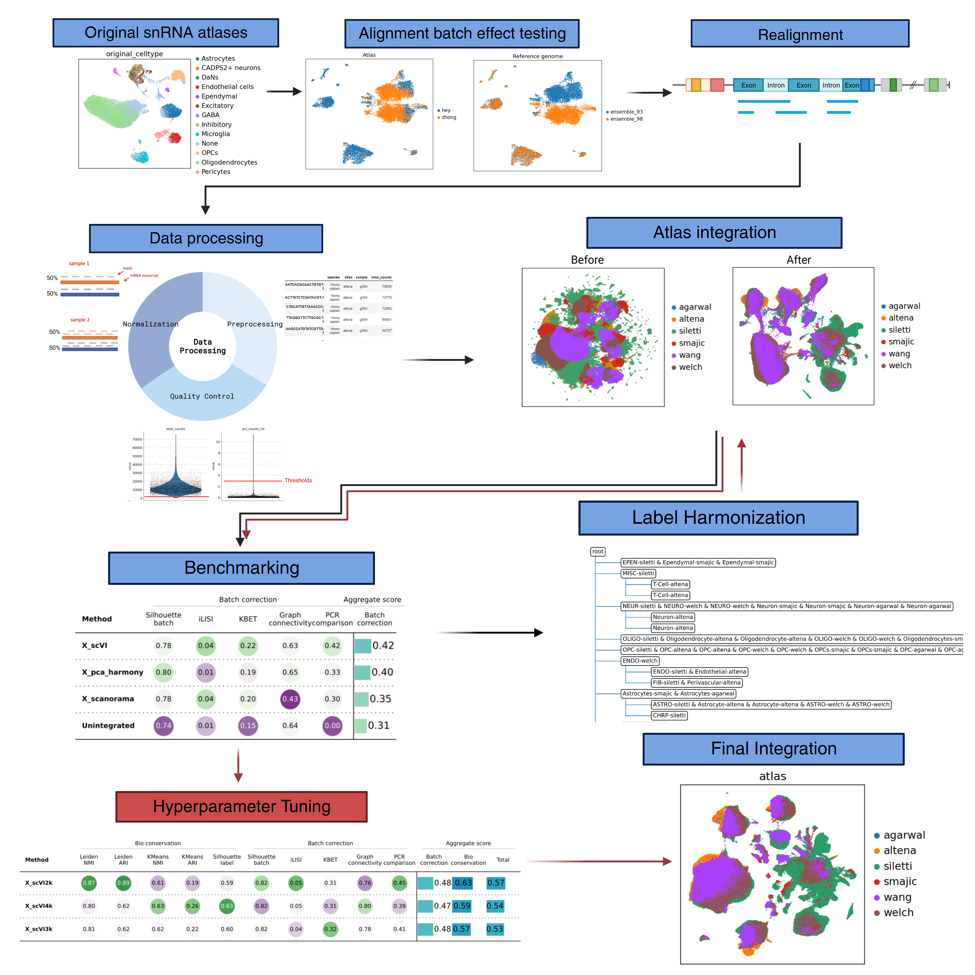
The Pipeline

Slide 7
The Pipeline
1. Tests and Atlas Processing

Slide 8
The Pipeline
1. Tests and Atlas Processing
2. Label Harmonization and Benchmarks

Slide 9
The Pipeline
1. Tests and Atlas Processing
2. Label Harmonization and Benchmarks
3. Final Integration and Analysis

Slide 10
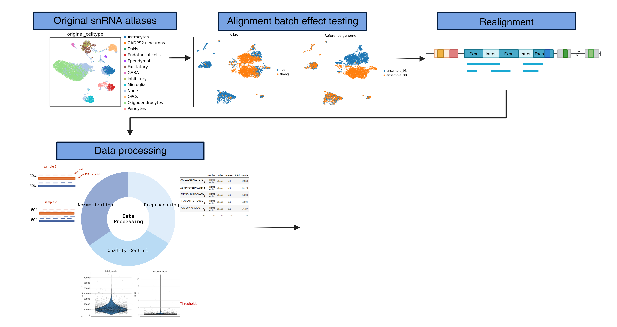
1. Tests and Atlas Processing

Slide 11
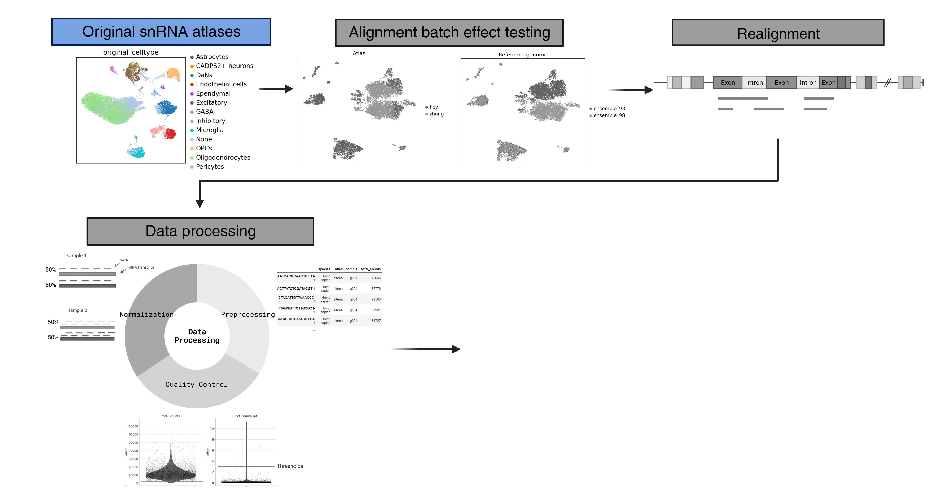
1.1 Original Atlases
snRNA atlas | Cells (unfiltered)
Siletti et. al. (2022) | ~300,000 (midbrain subset)
Smajic et. al. (2021) | ~30,000 (midbrain)
Agarwal et. al. (2021) | ~10,000 (substantia nigra)
Wang et. al. (2022) | ~150,000 (substantia nigra)
Welch et. al. (2019) | ~45,000 (substantia nigra)
van Regteren Altena et. al. | ~90,000 (VTA)
Total | ~625,000 cells

Slide 12
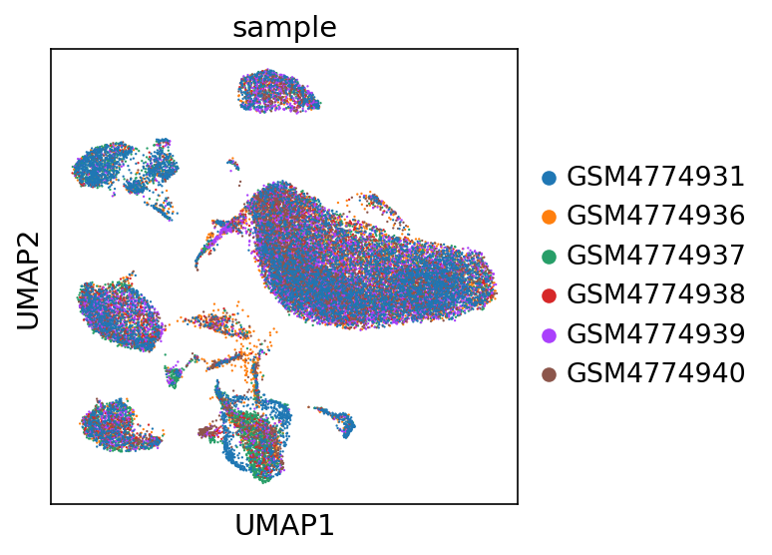
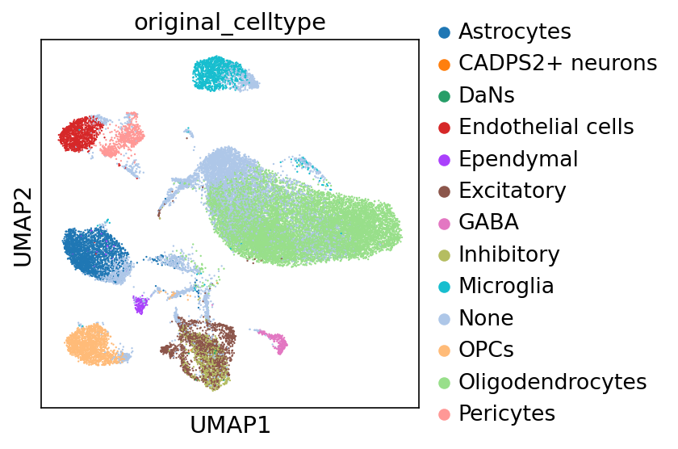
Smajic atlas

Slide 13
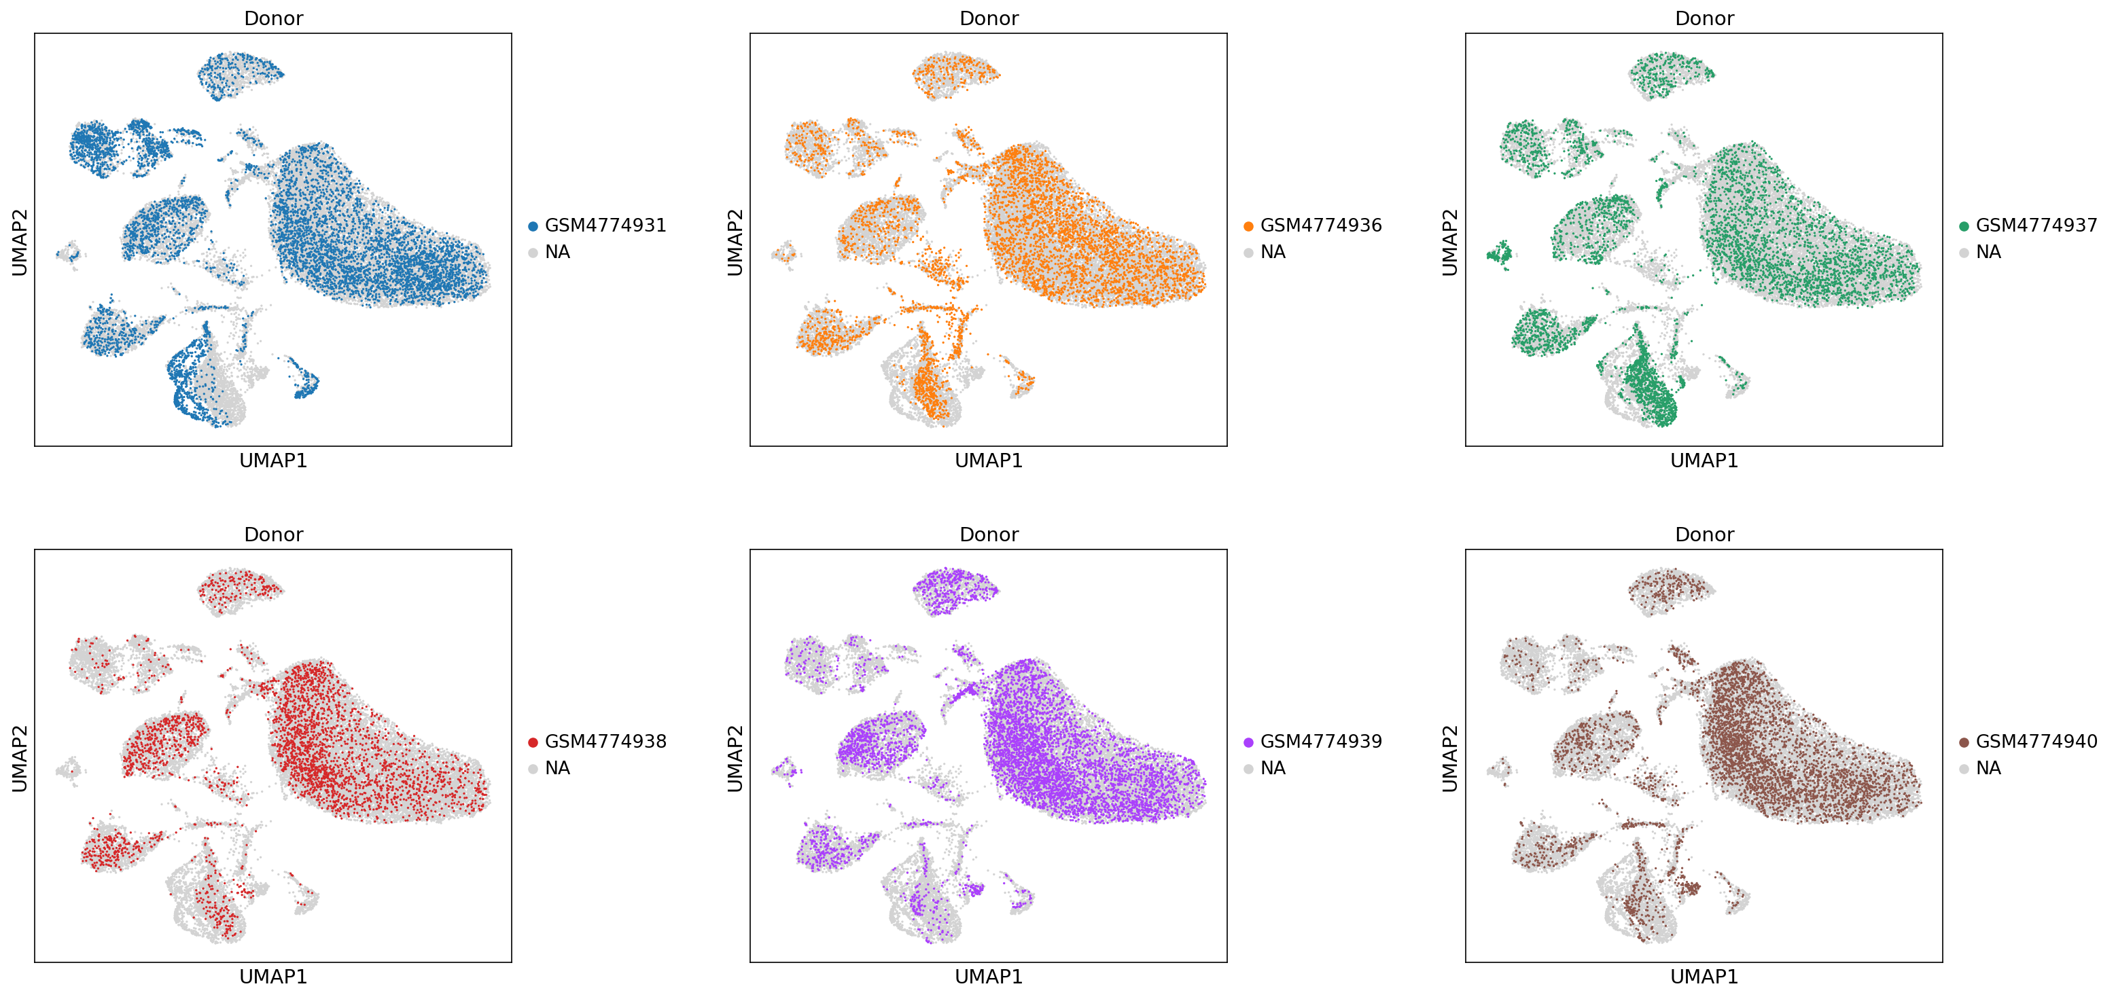
Smajic samples

Slide 14
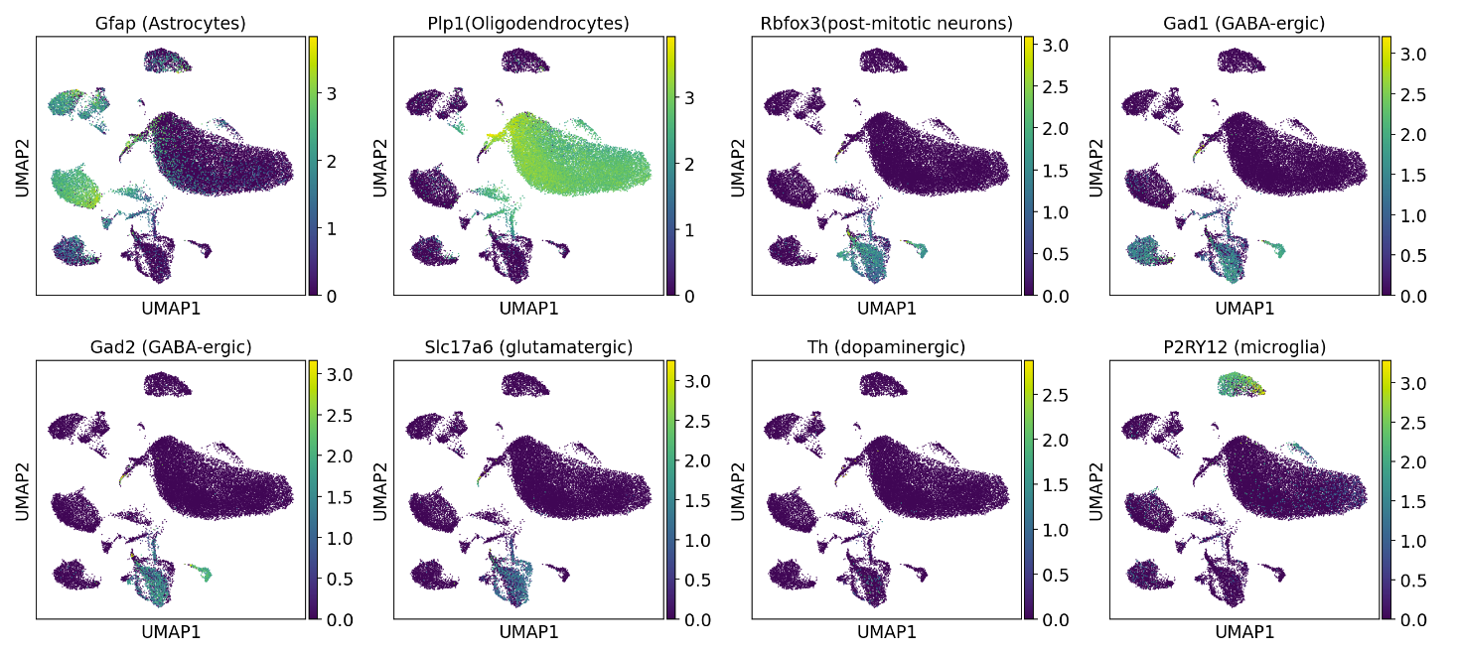
Smajic markers

Slide 15
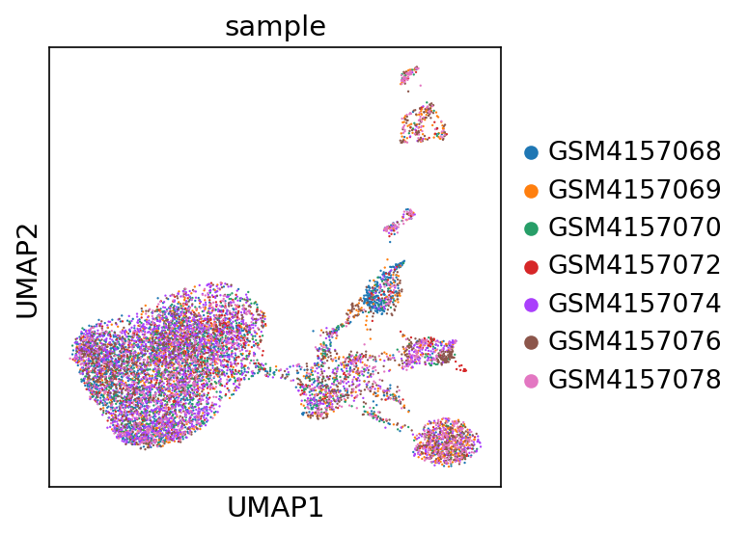
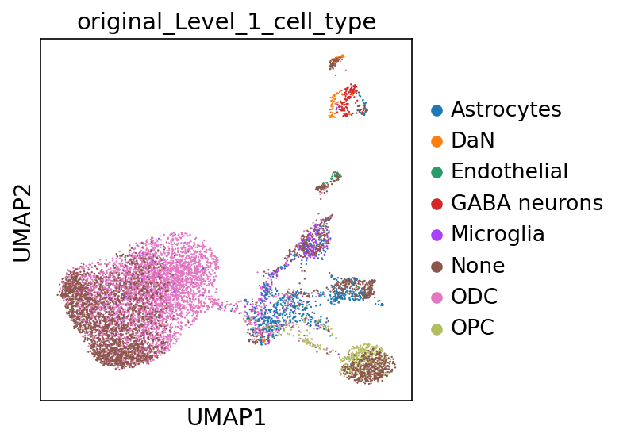
Agarwal atlas

Slide 16
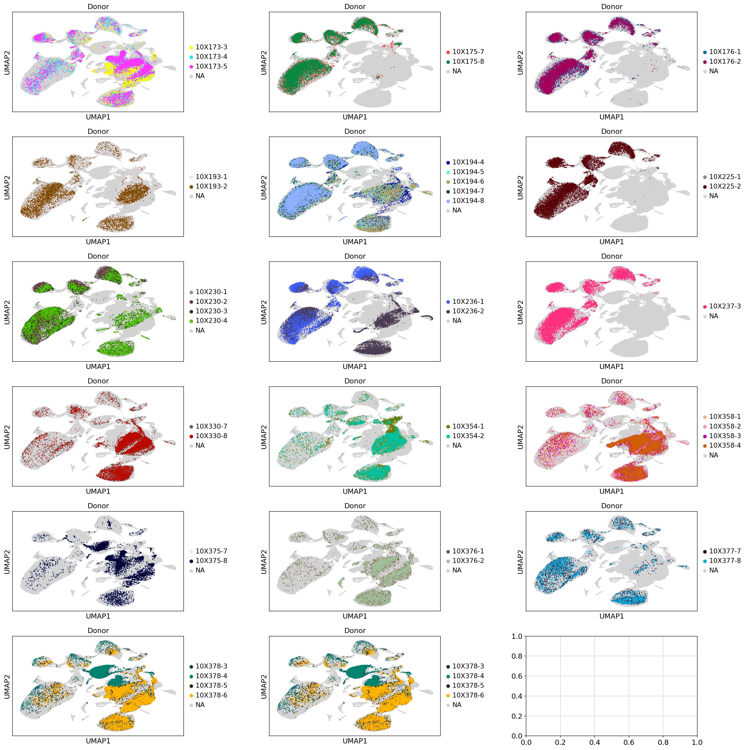
Siletti samples

Slide 17
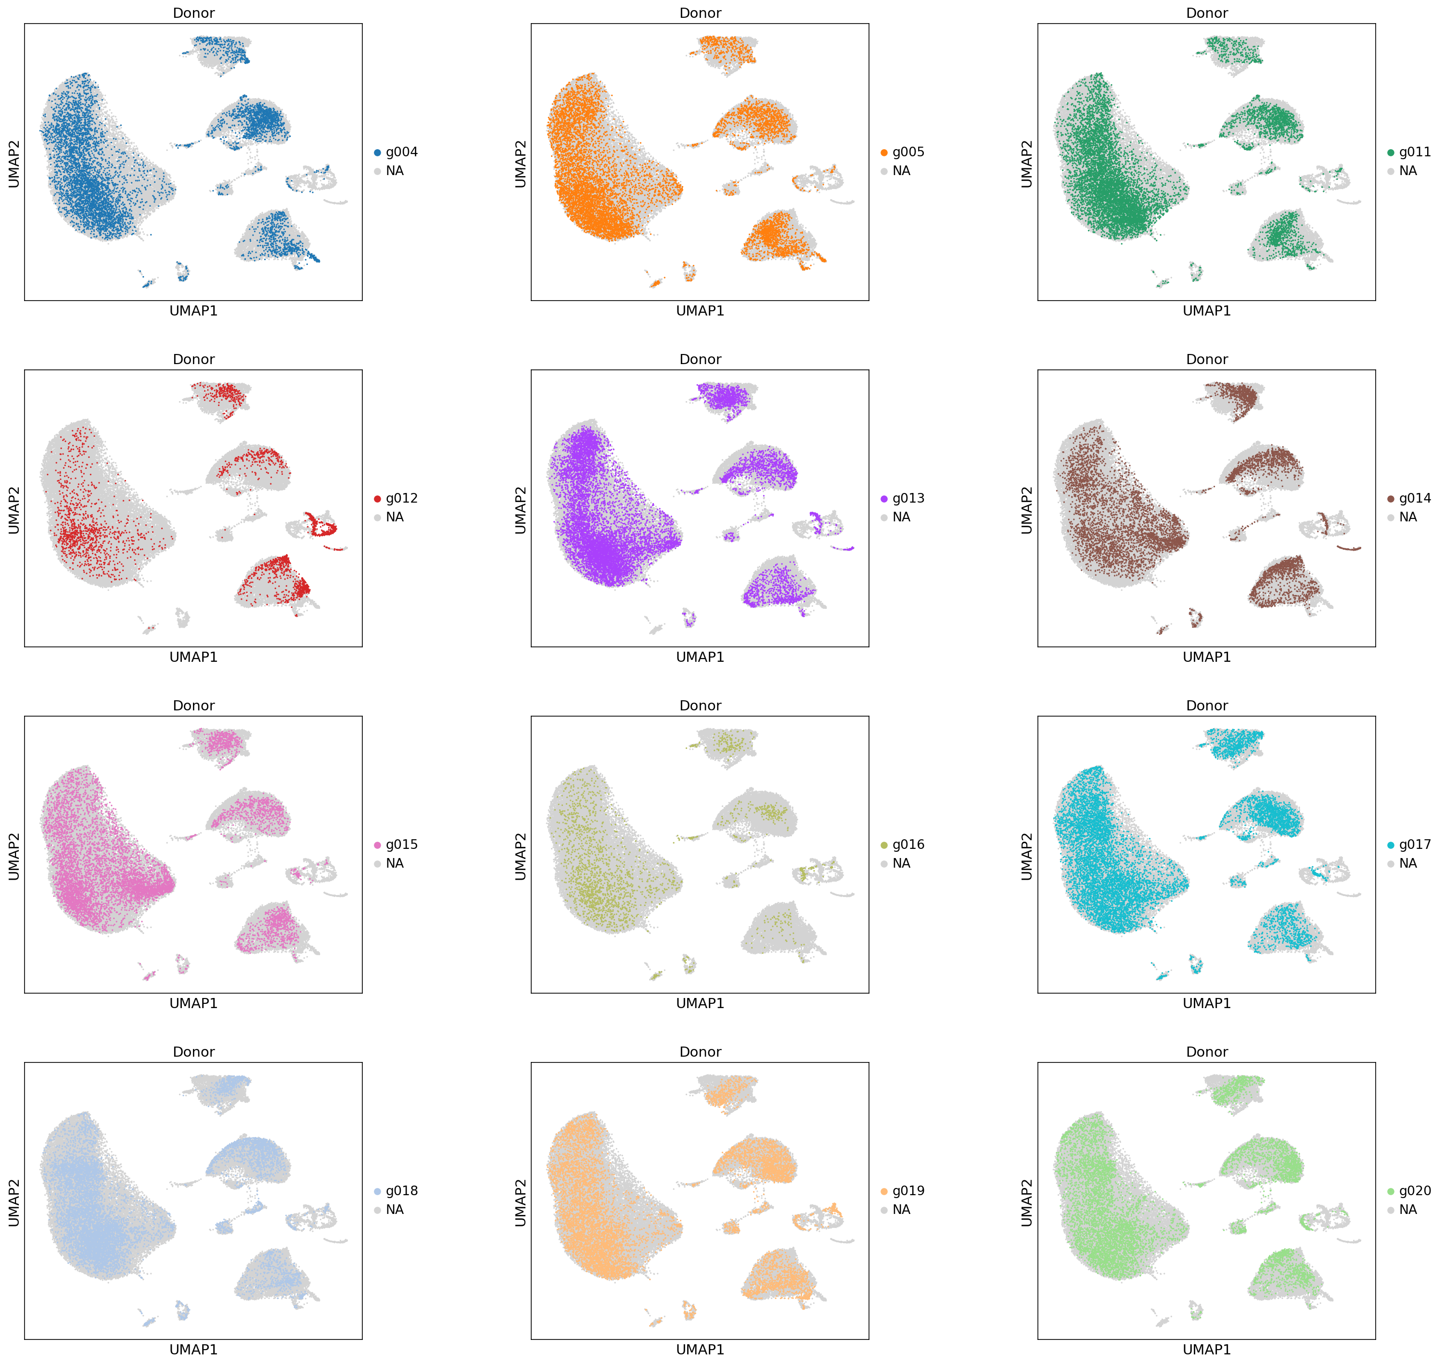
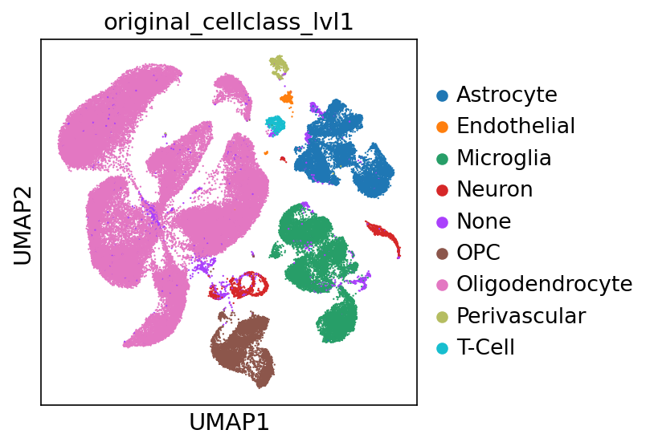
Altena samples

Slide 18
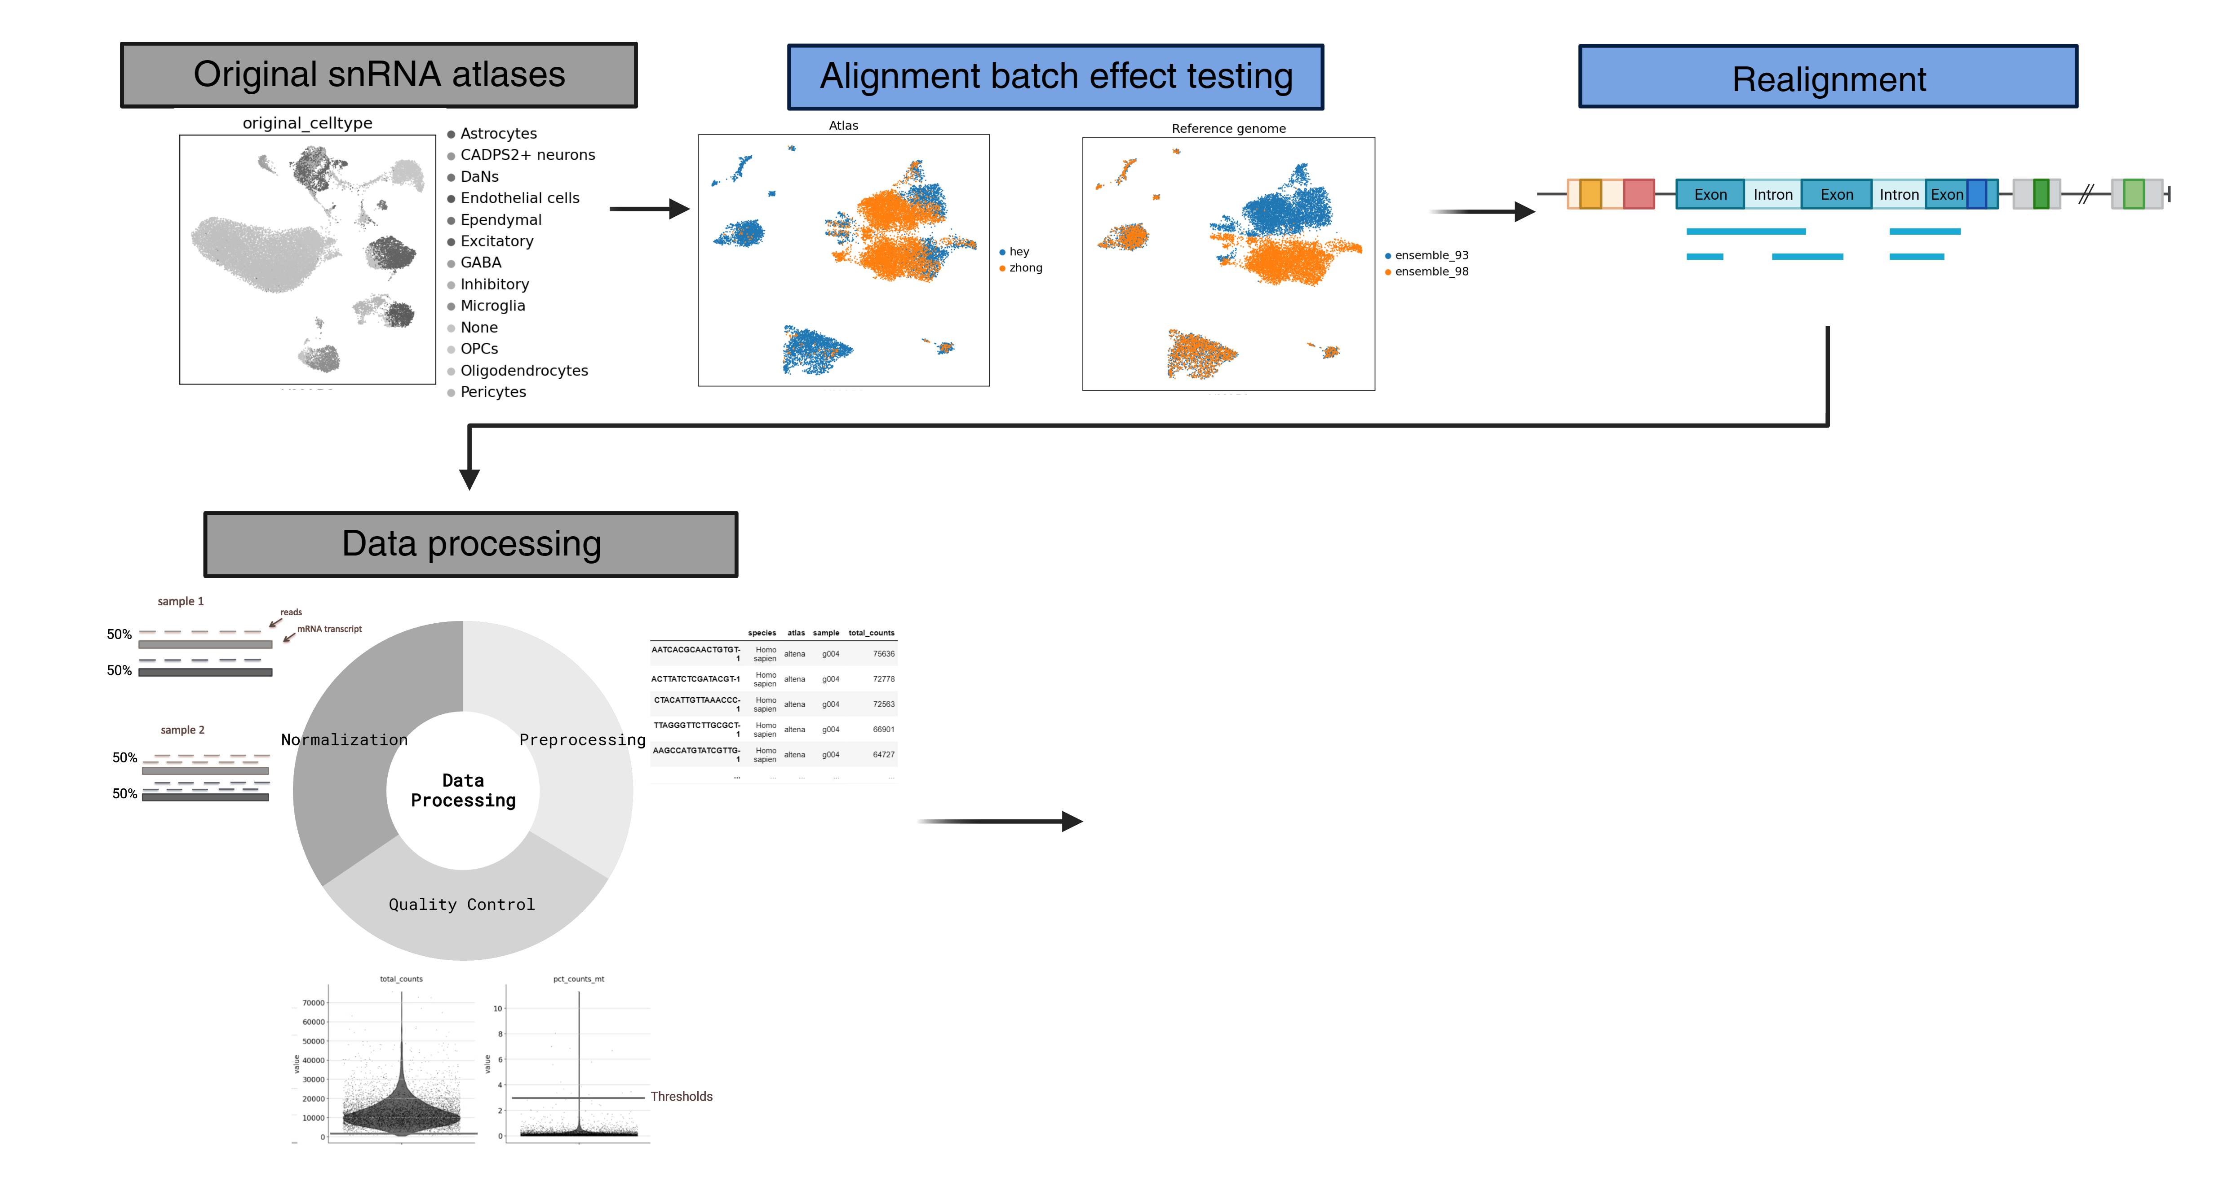
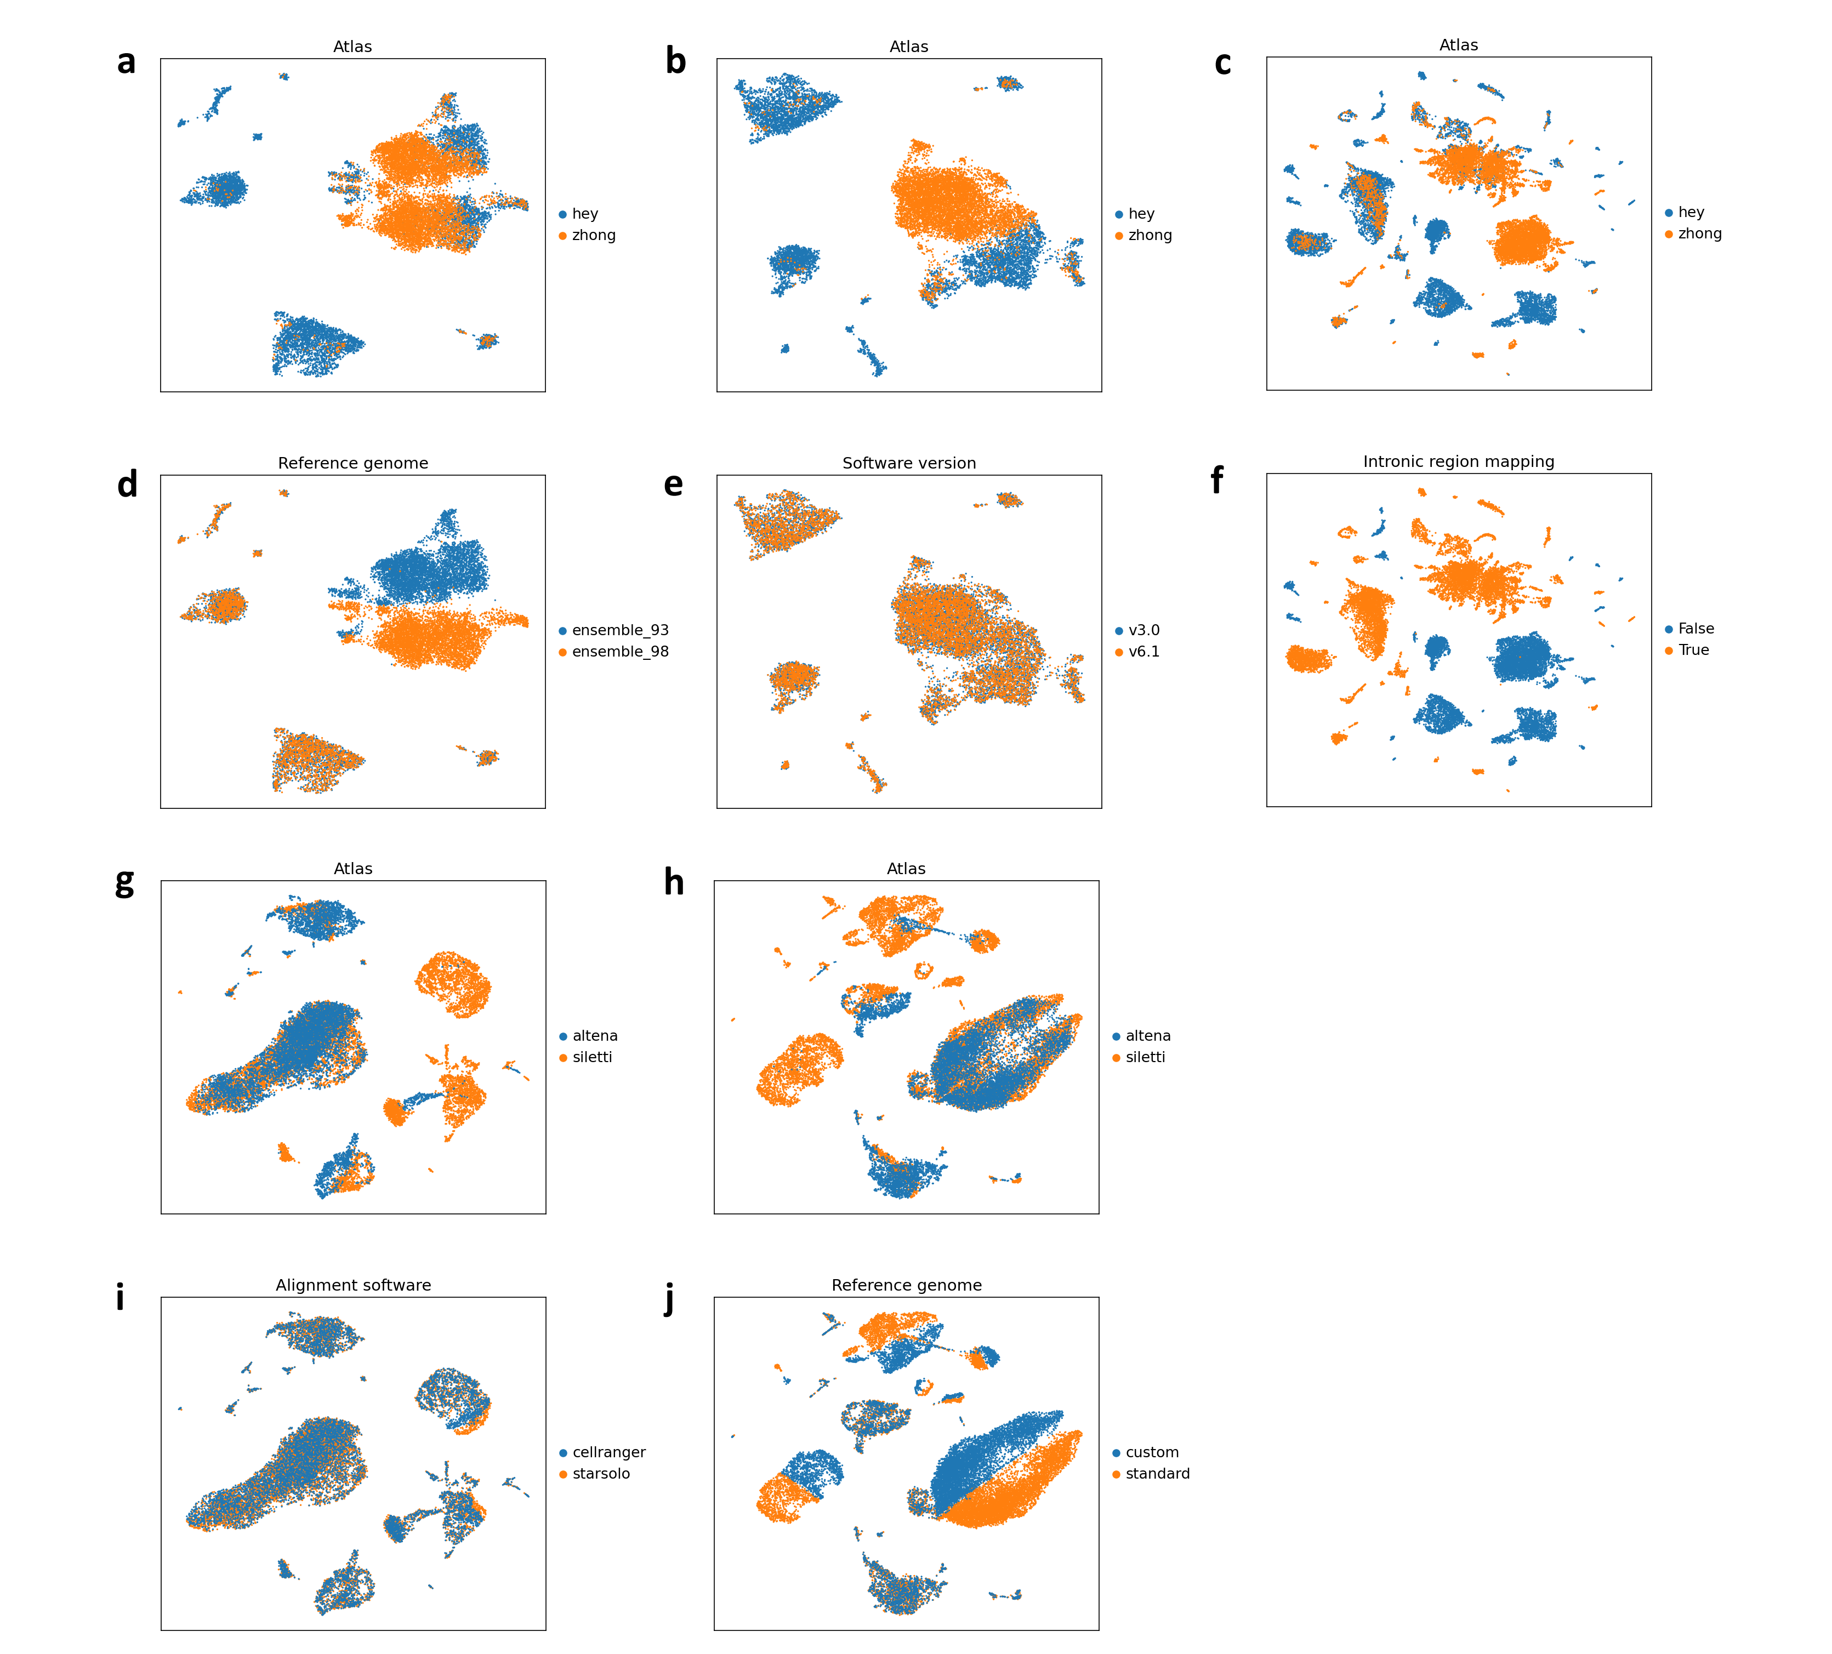
1.2 Tests and Realignment
Problem: Batch effects
Reference genome: Ensemble 93 vs 98
Software version (Cell Ranger): Cell Ranger v3.0 vs v6.1
Include intronic mapping: True vs False

Slide 19
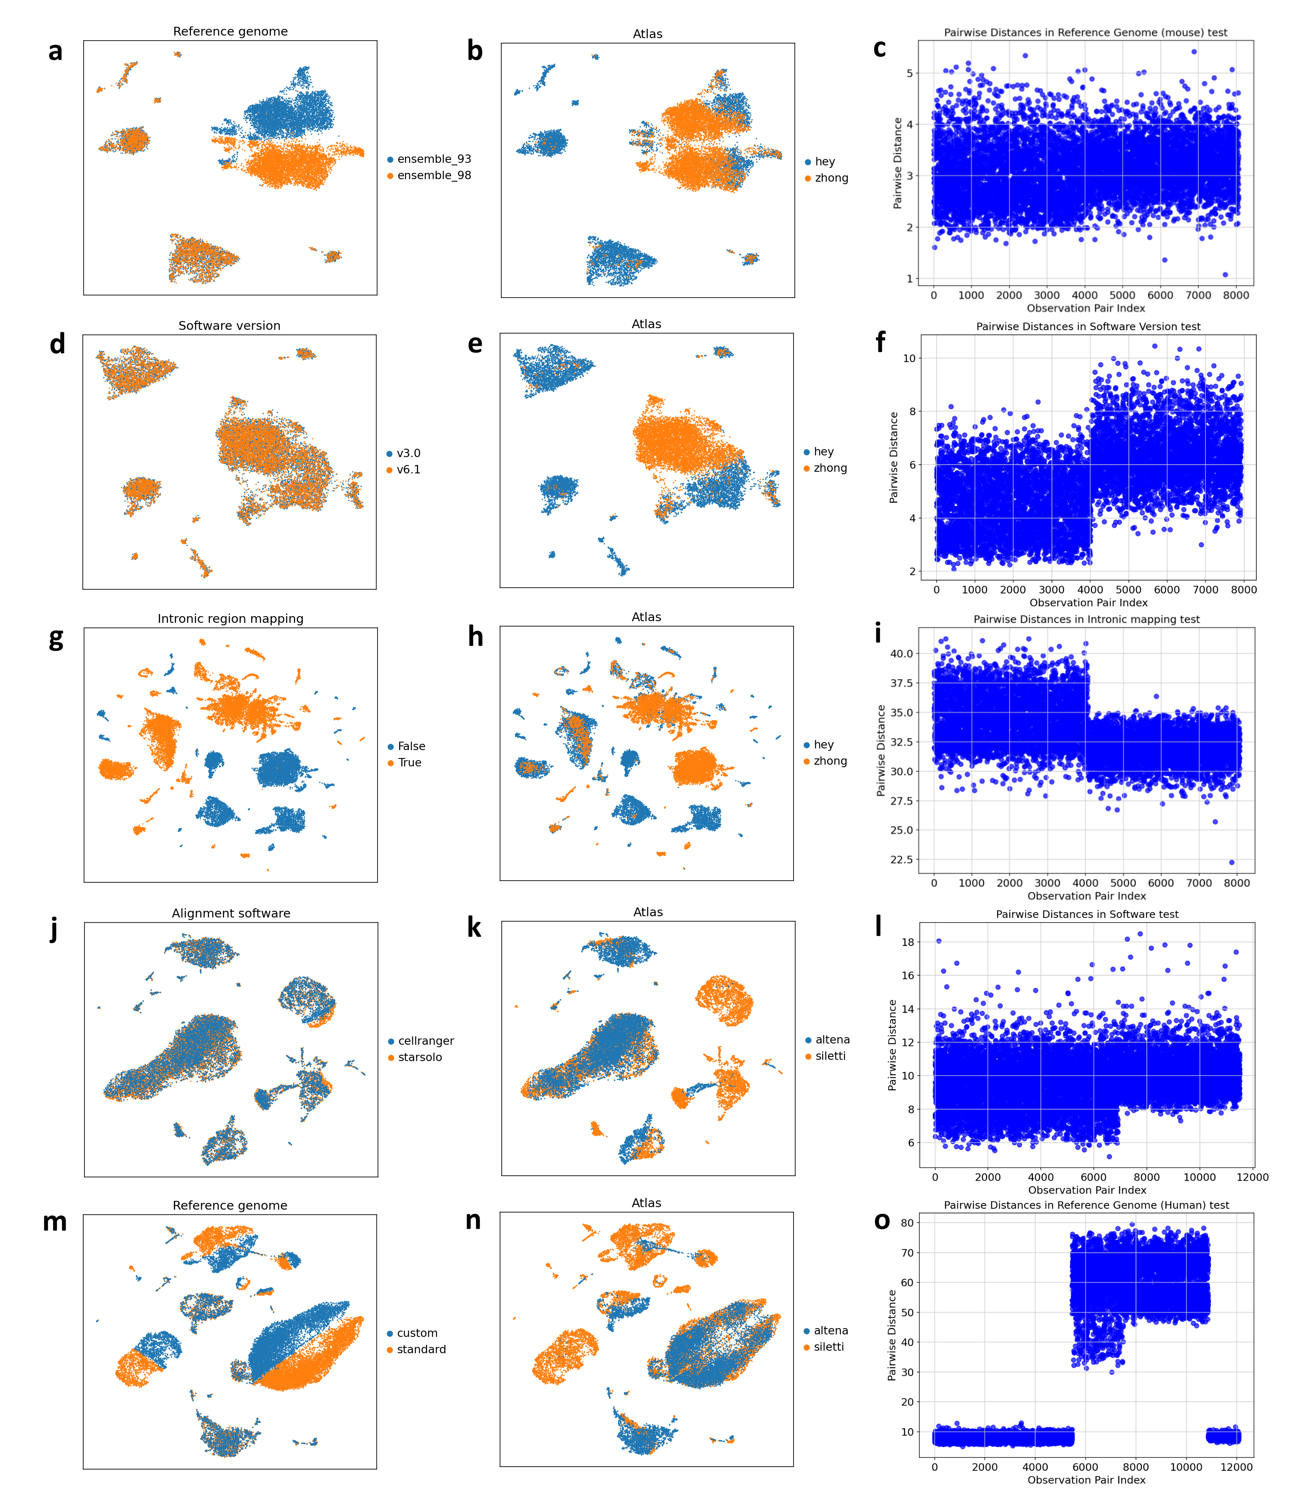

Slide 21
1.2 Tests and Realignment
Problem: Batch effects
Software: Cell Ranger vs STARsolo
Reference genome: Ensemble 109 vs custom

Slide 22
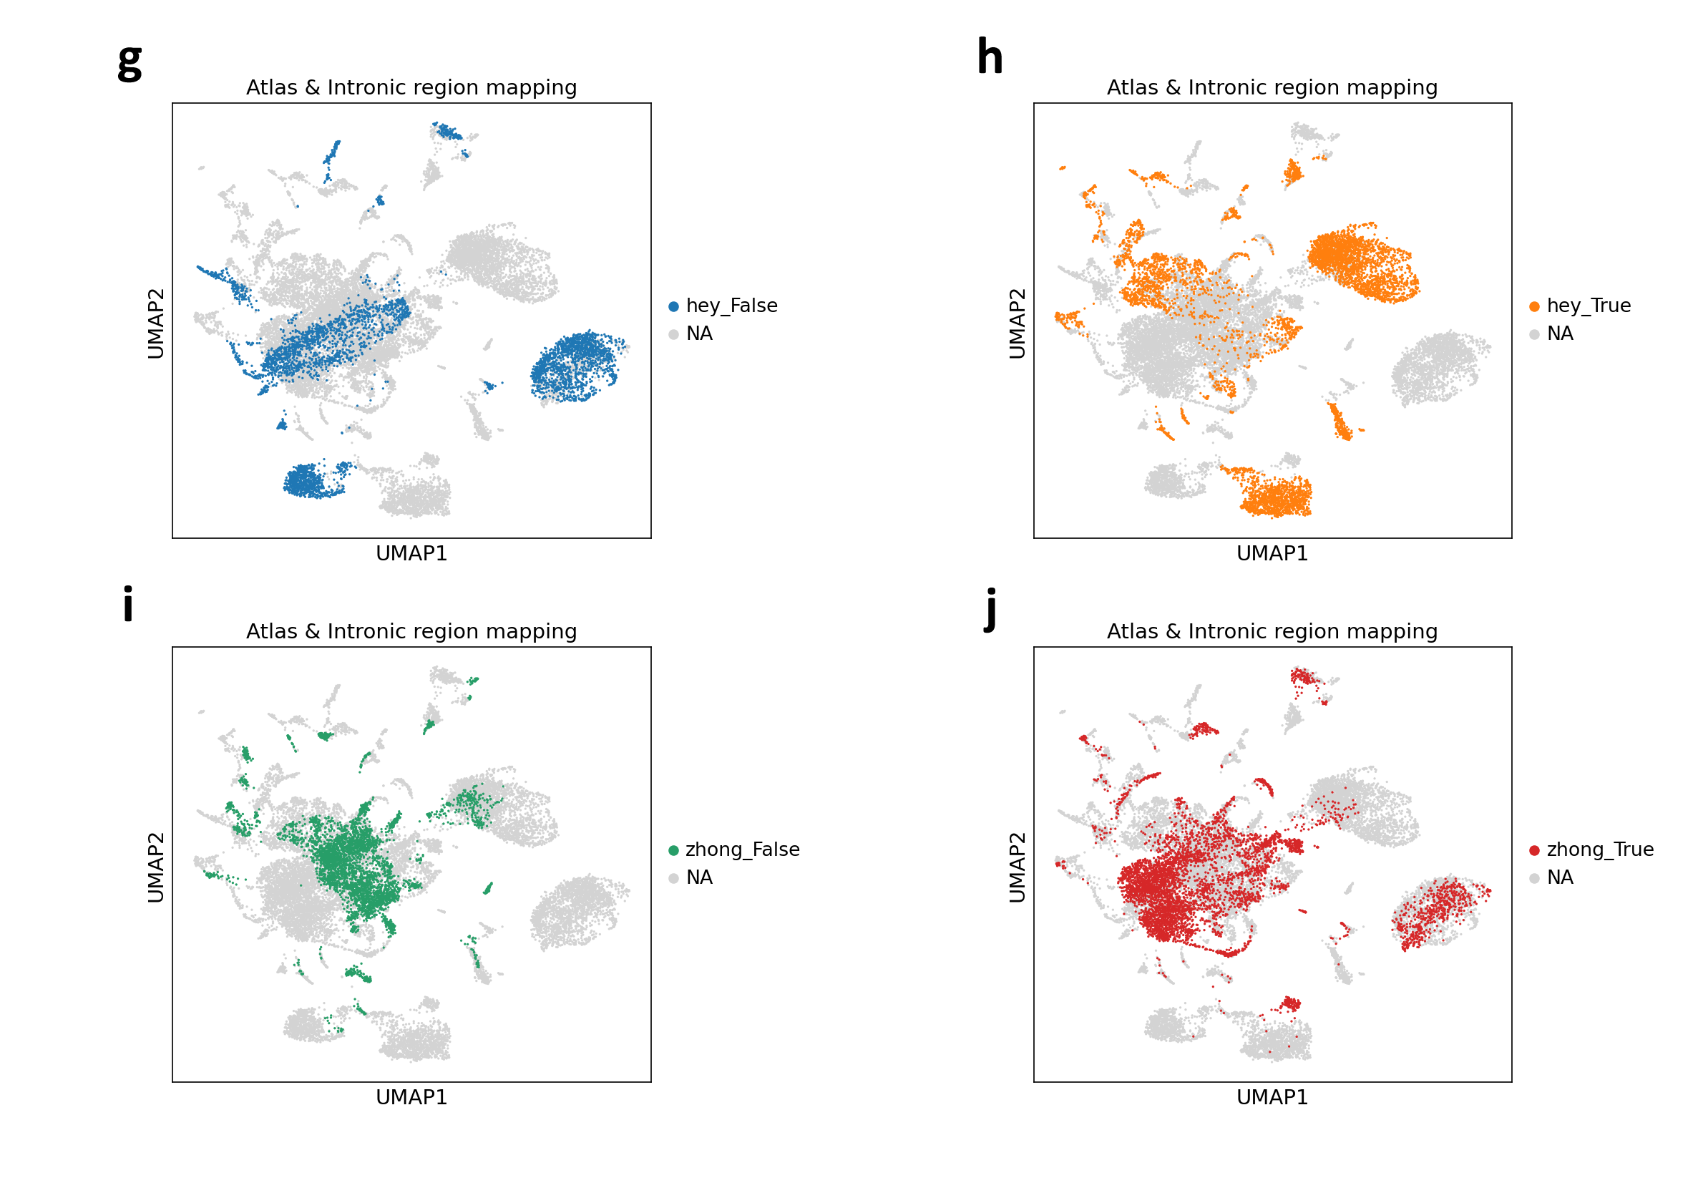
More tests: intronic mapping regress and highly-variable genes

Slide 23
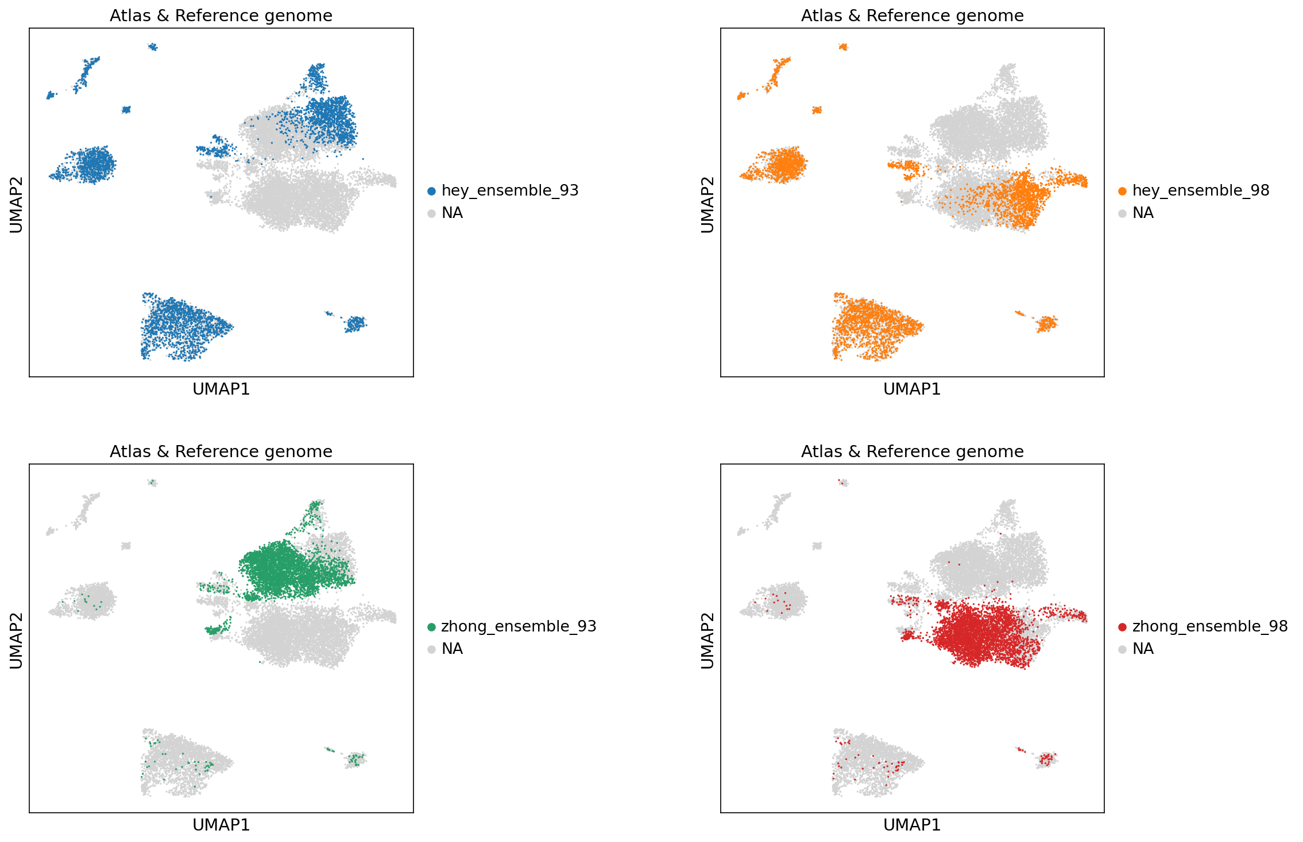
More tests: reference genome mouse

Slide 24
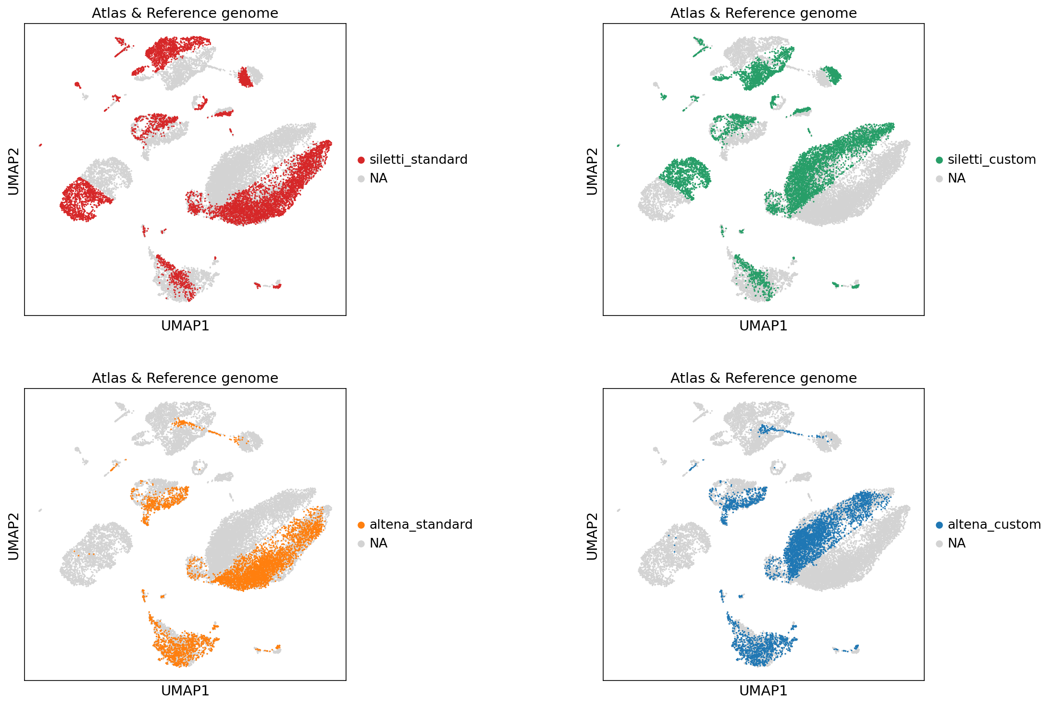
More tests: reference genome (human)

Slide 25
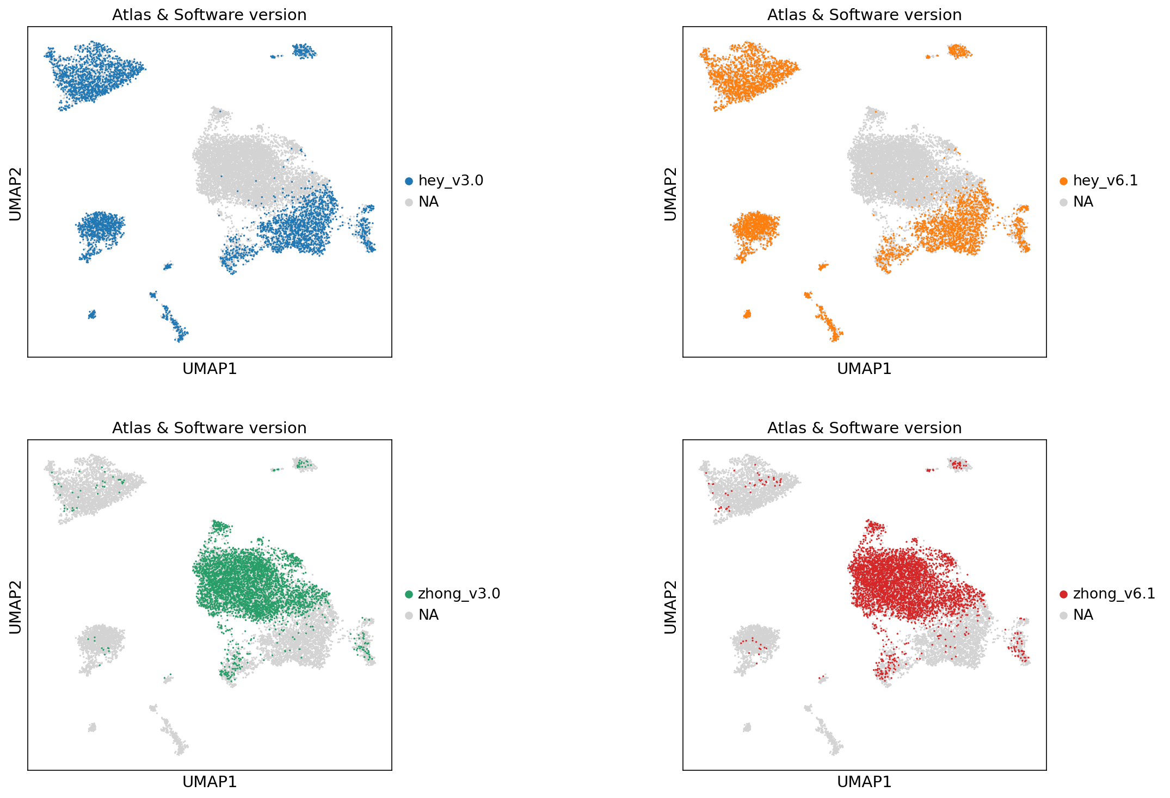
More tests: software version

Slide 26
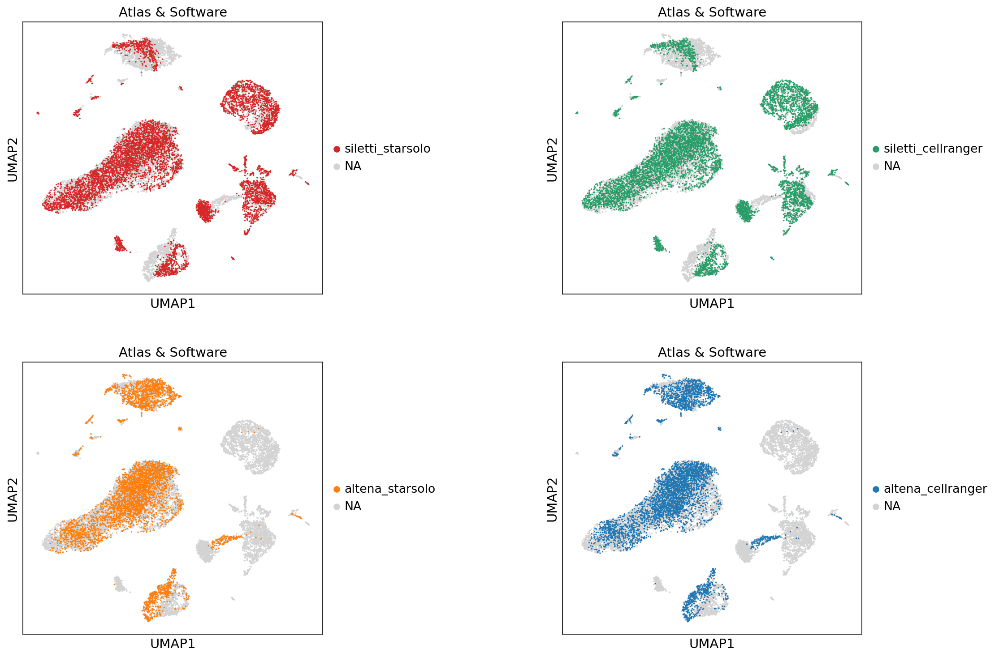
More tests: software (human)

Slide 27
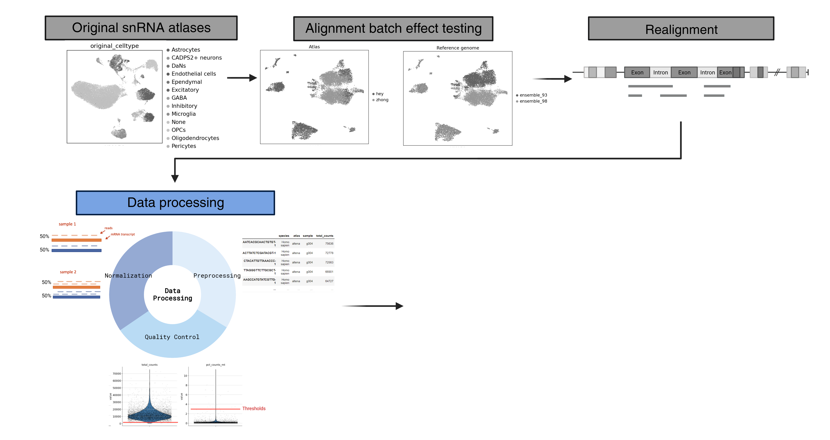
1.3 Data processing

Slide 28
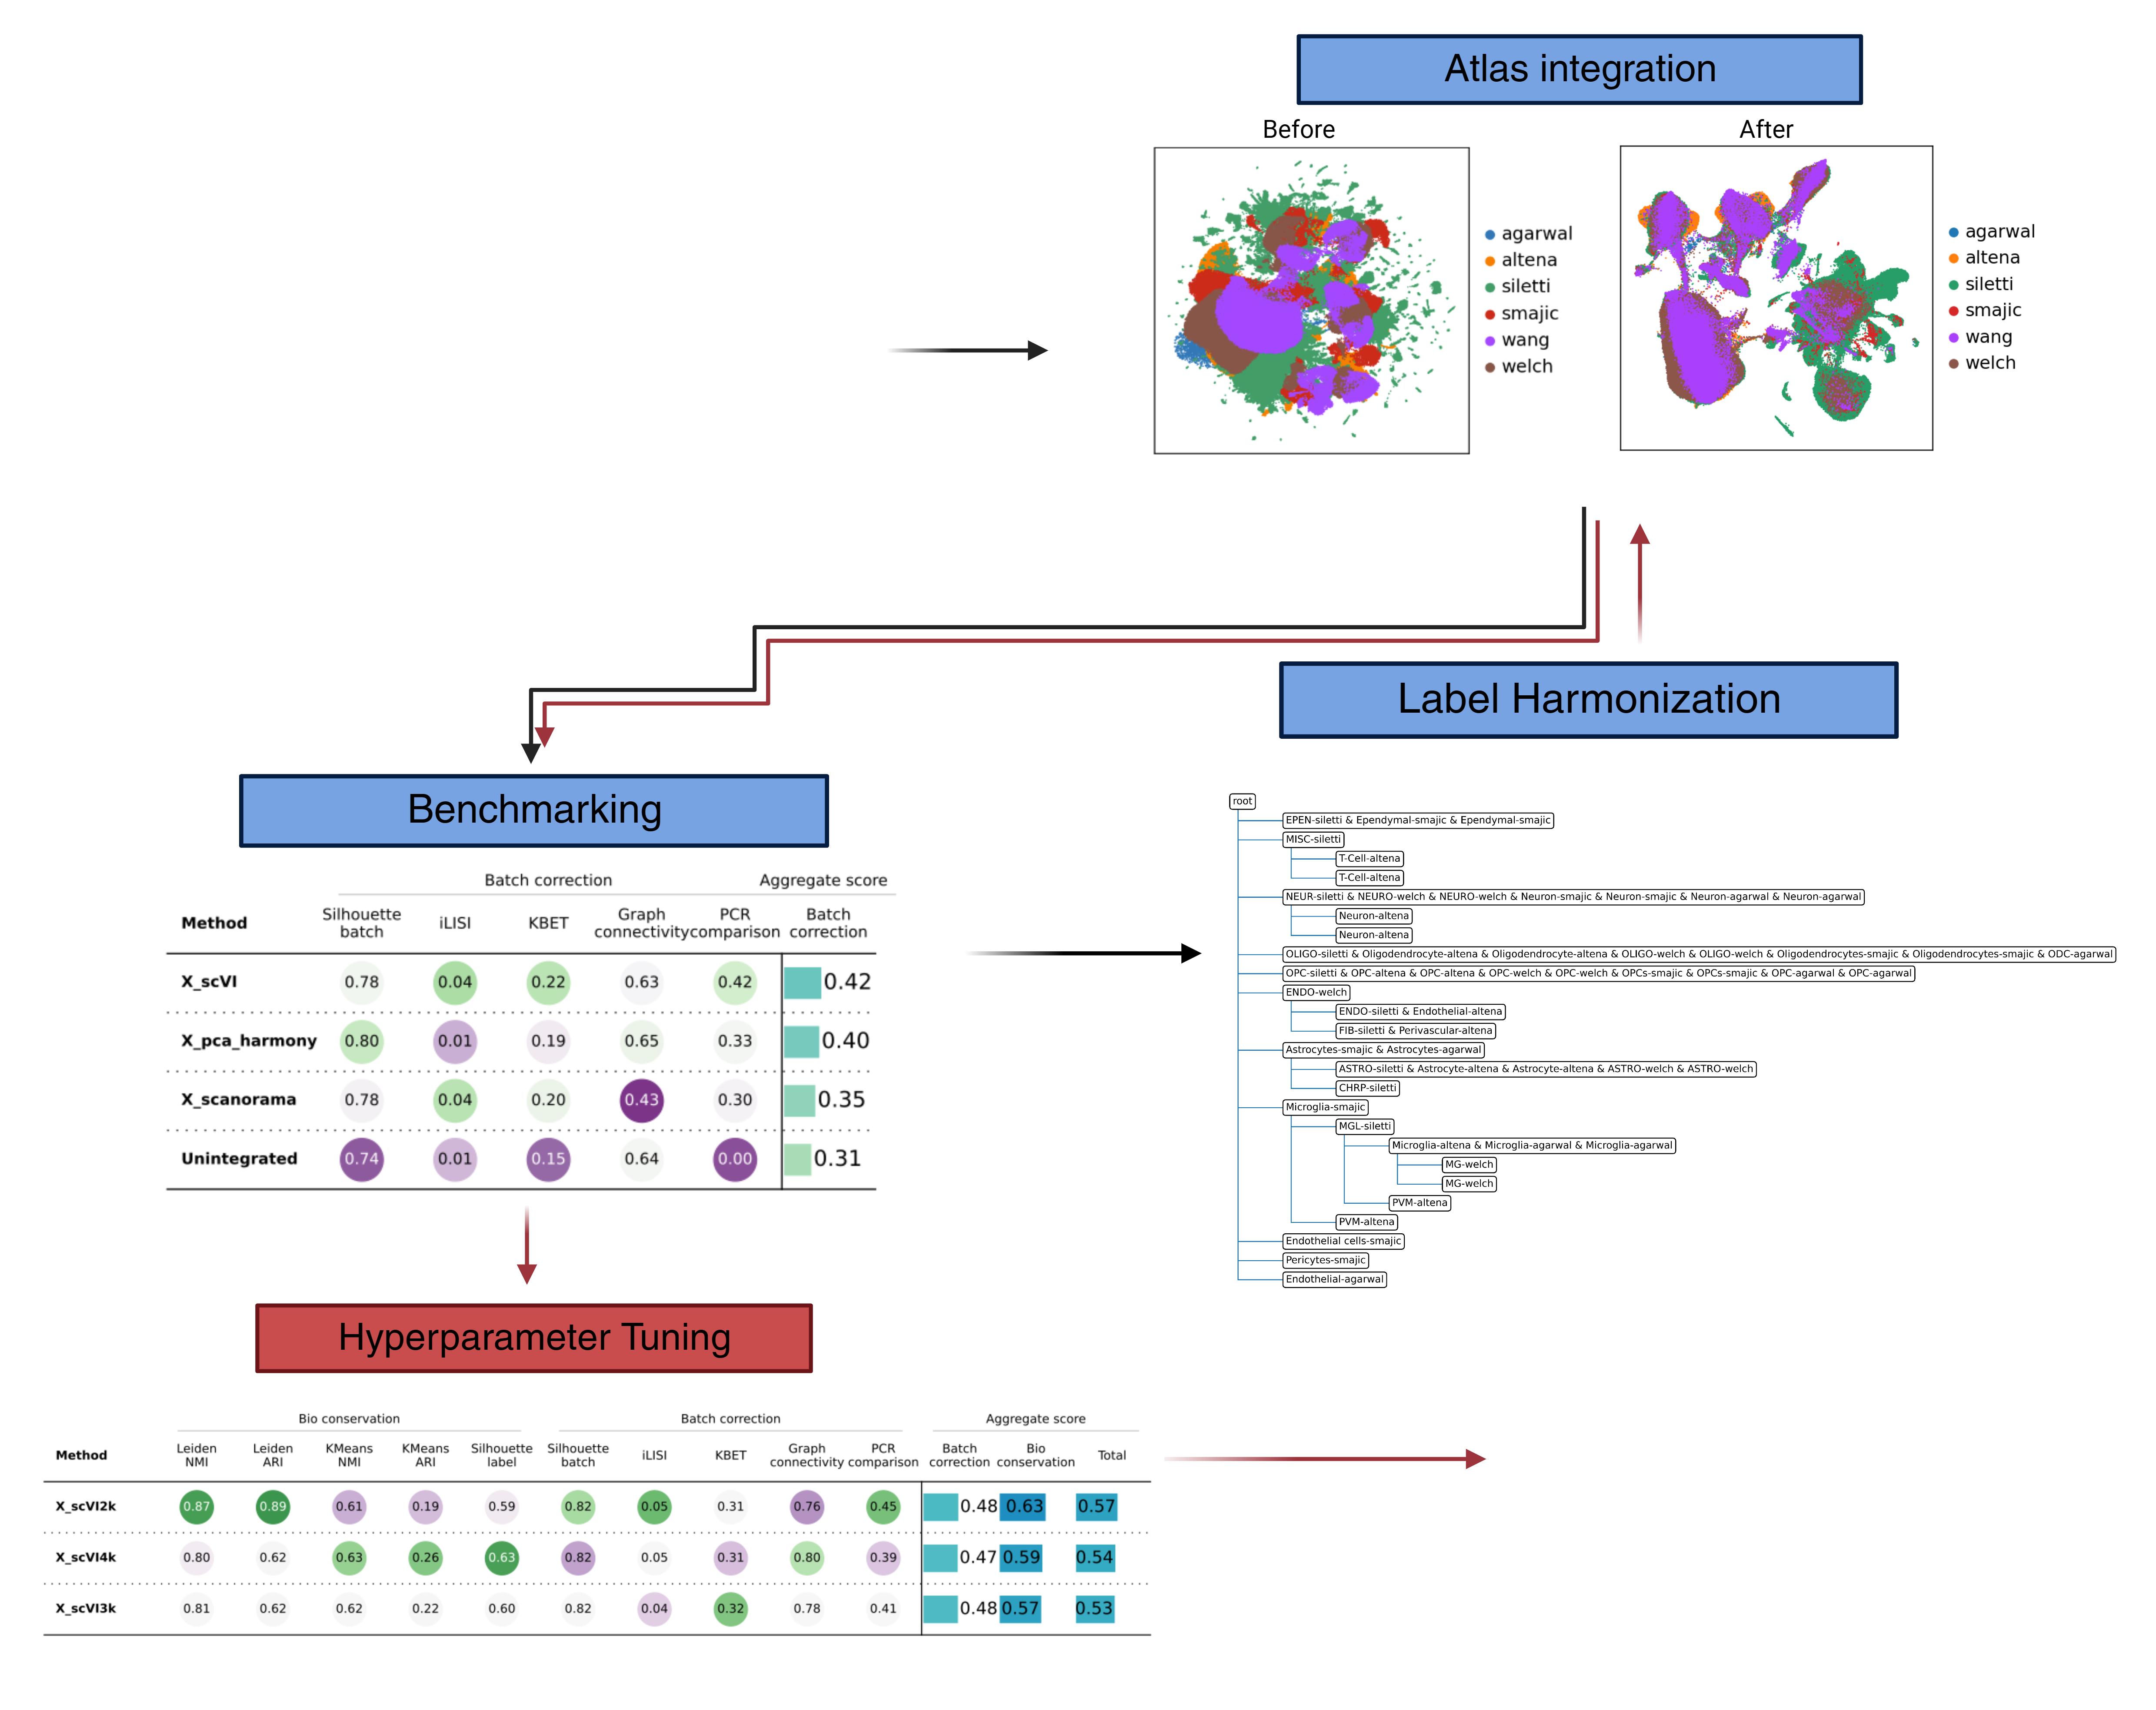
2. Label Harmonization and Benchmarks

Slide 29
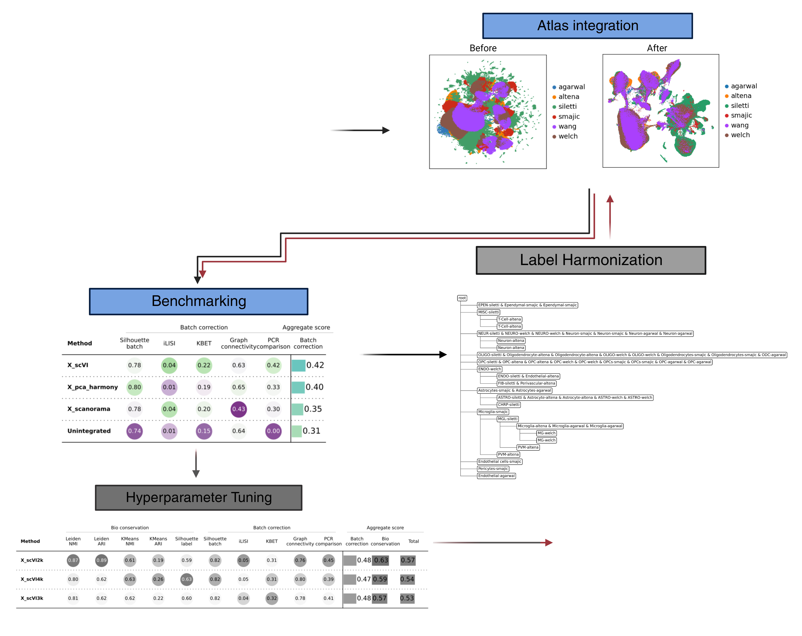
2.1 Integration evaluation (with Scib)
Problem: Which integration method to use?

Slide 30
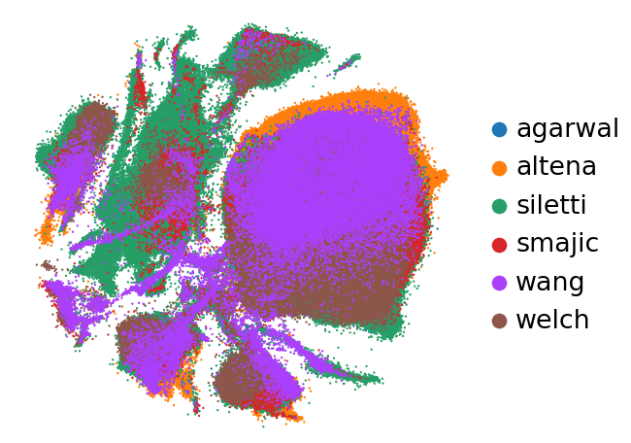
2.1 Integration evaluation (with Scib)
Problem: Which integration method to use?

Slide 31
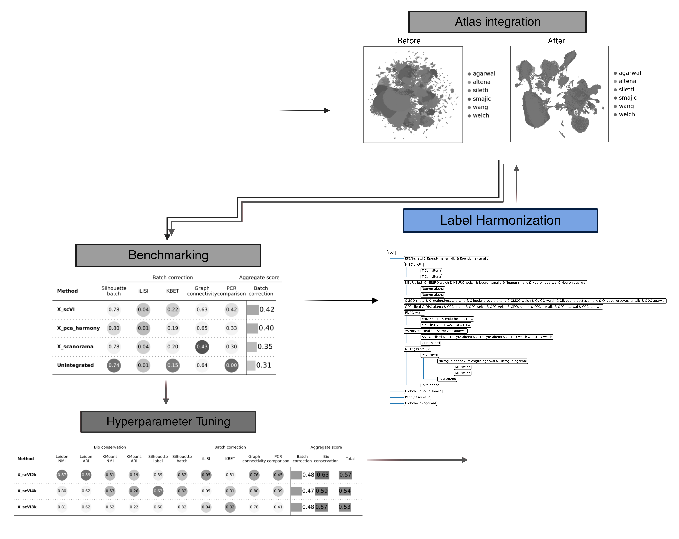
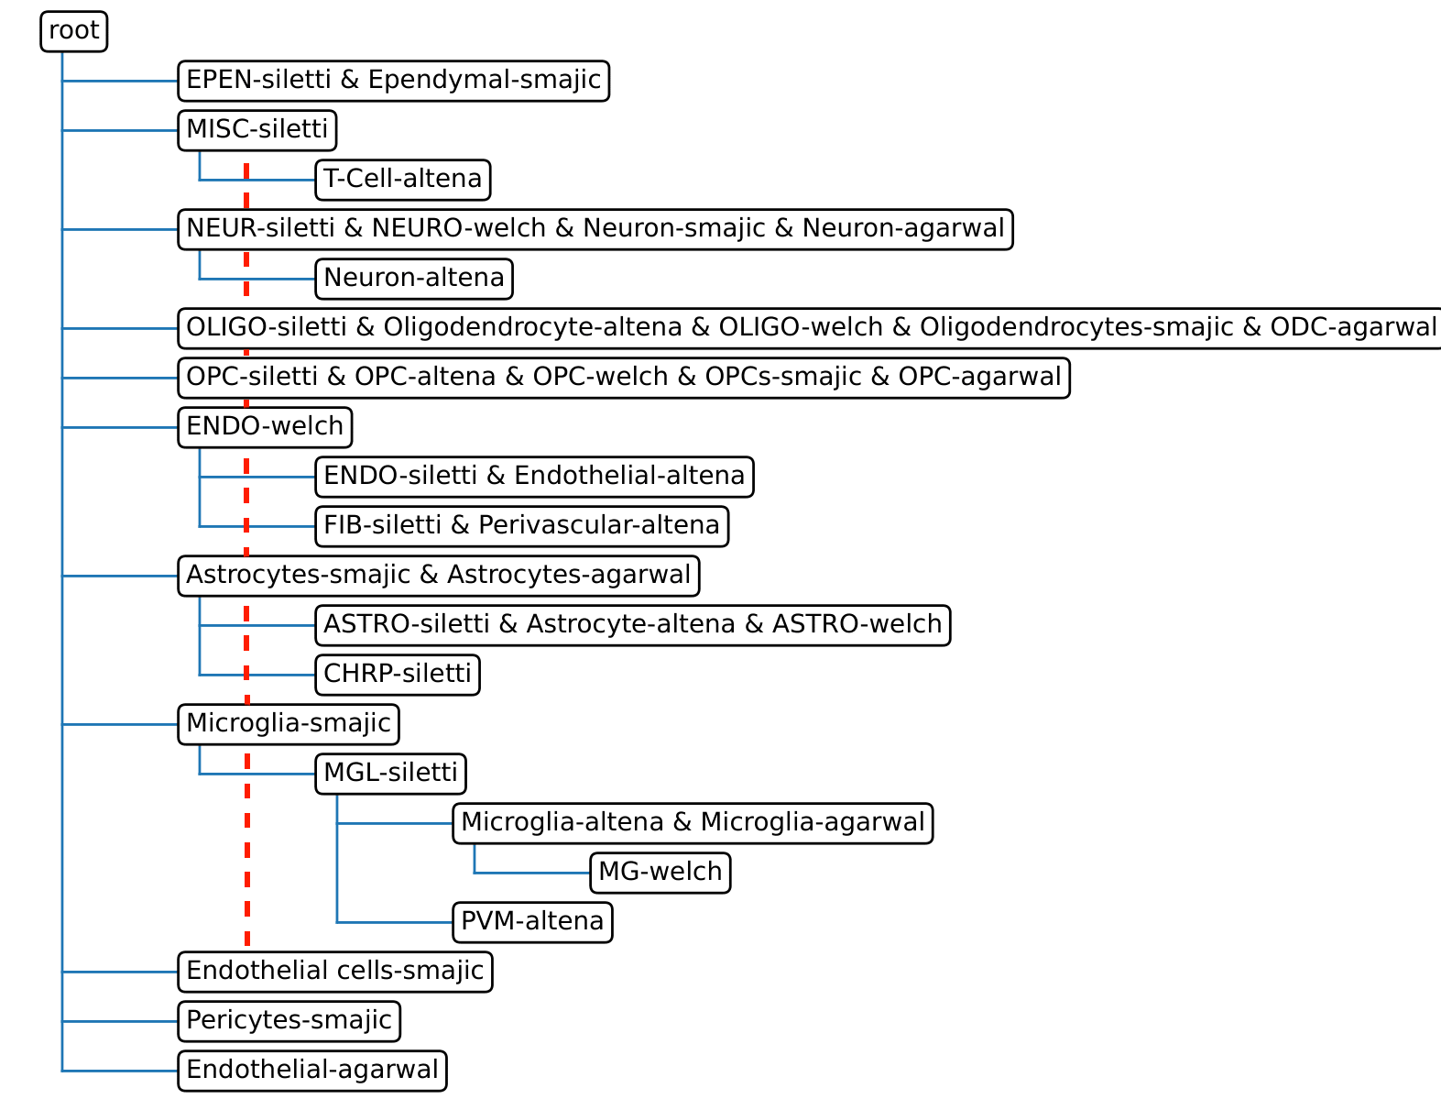
2.2 Label Harmonization (with scHPL)
Problem: Unique labels and specific resolution levels

Slide 32
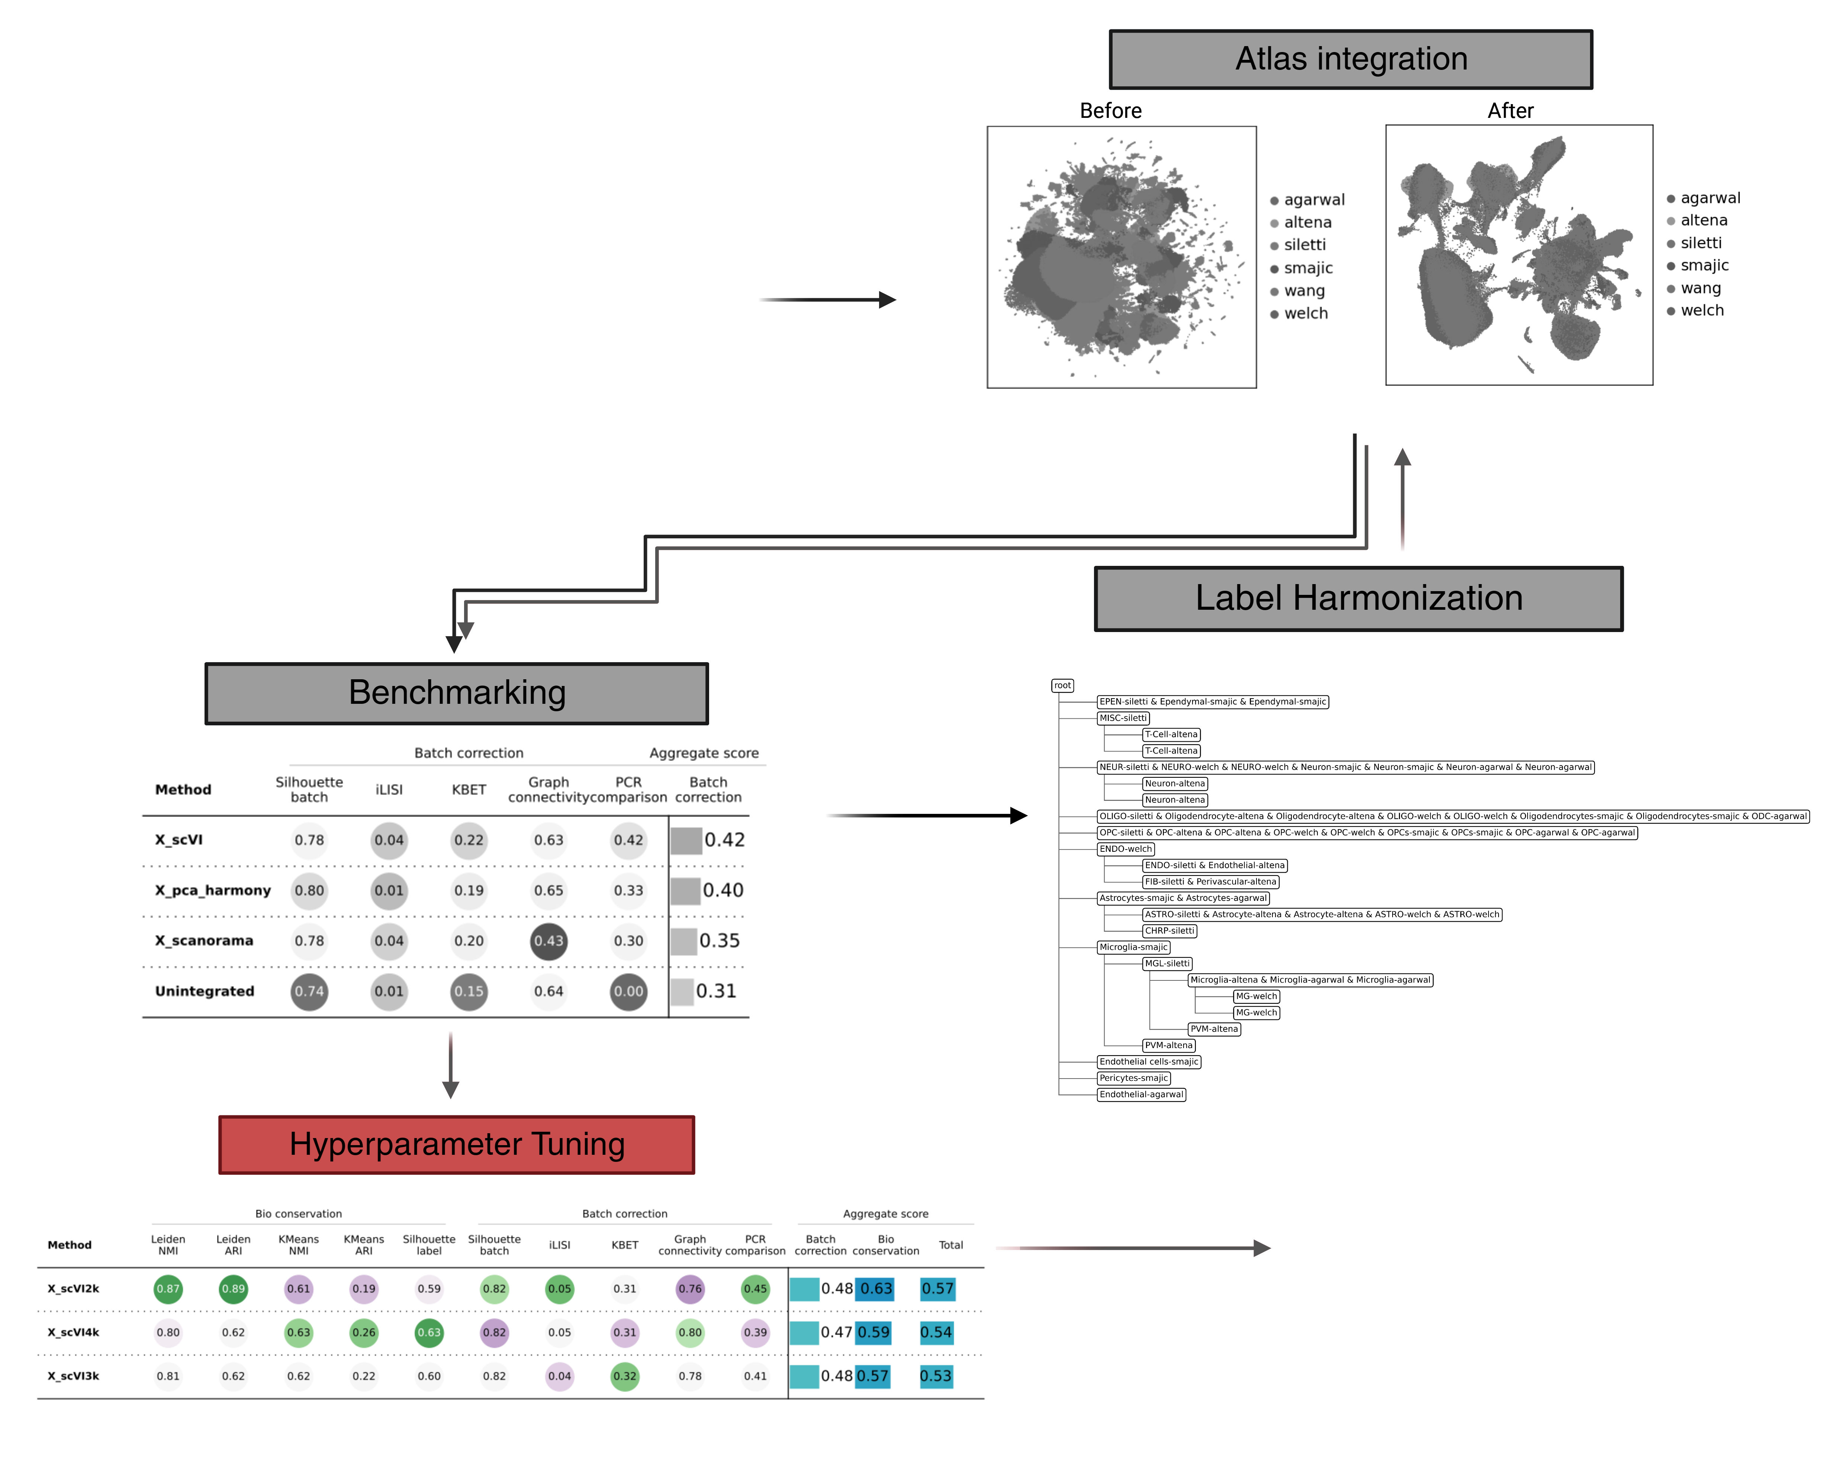
2.3 Hyperparameter Tuning
Hyperparameters of scVI
# Highly Variable Genes (2k, 3k, 4k)
# Latent Features (10, 50, 90)
# Hidden Layer (1, 3, 5)
# Hidden Nodes (64, 128, 256)
!Evaluated independently and include bio-conservation metrics

Slide 33
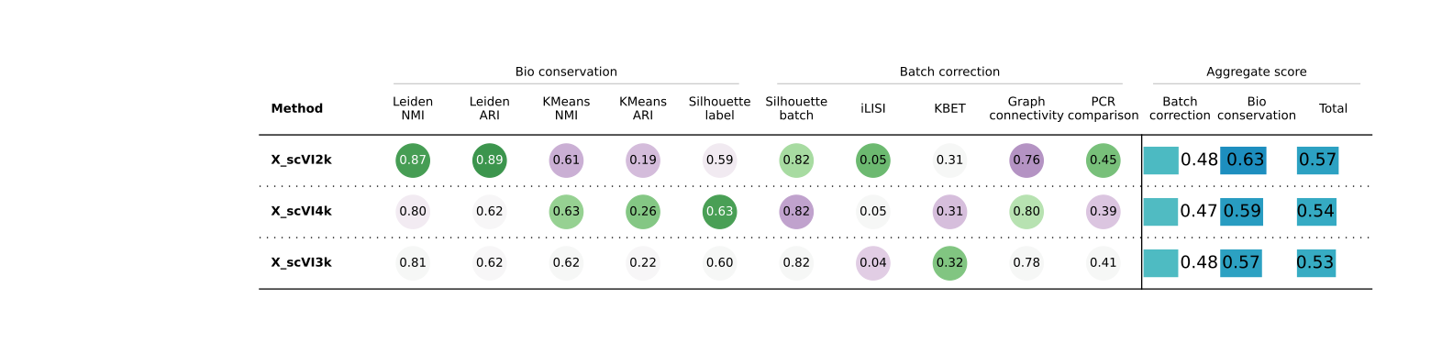
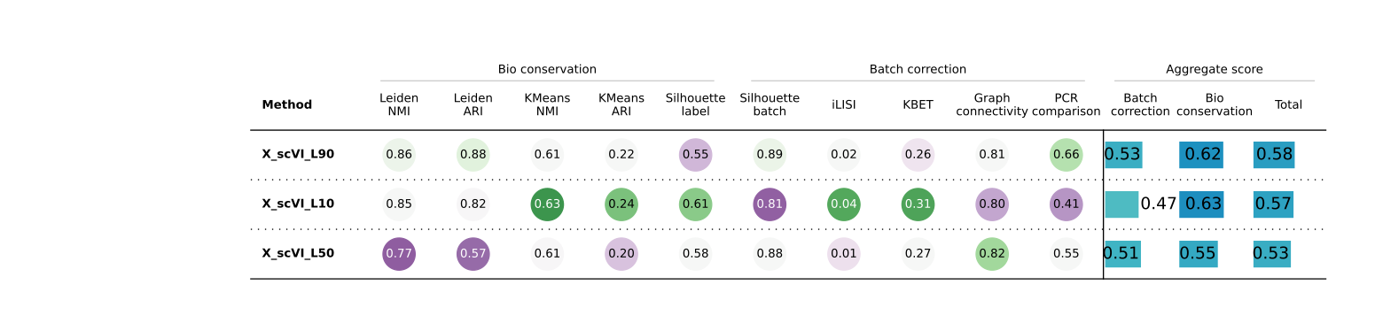
# High-Variance Genes and Latent Features

Slide 34
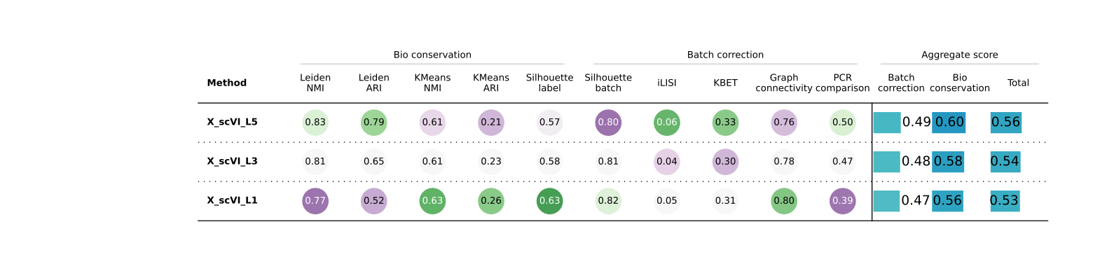
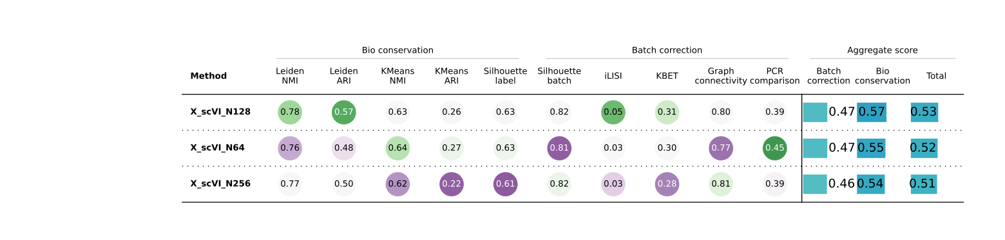
# Hidden Layer and Nodes

Slide 35
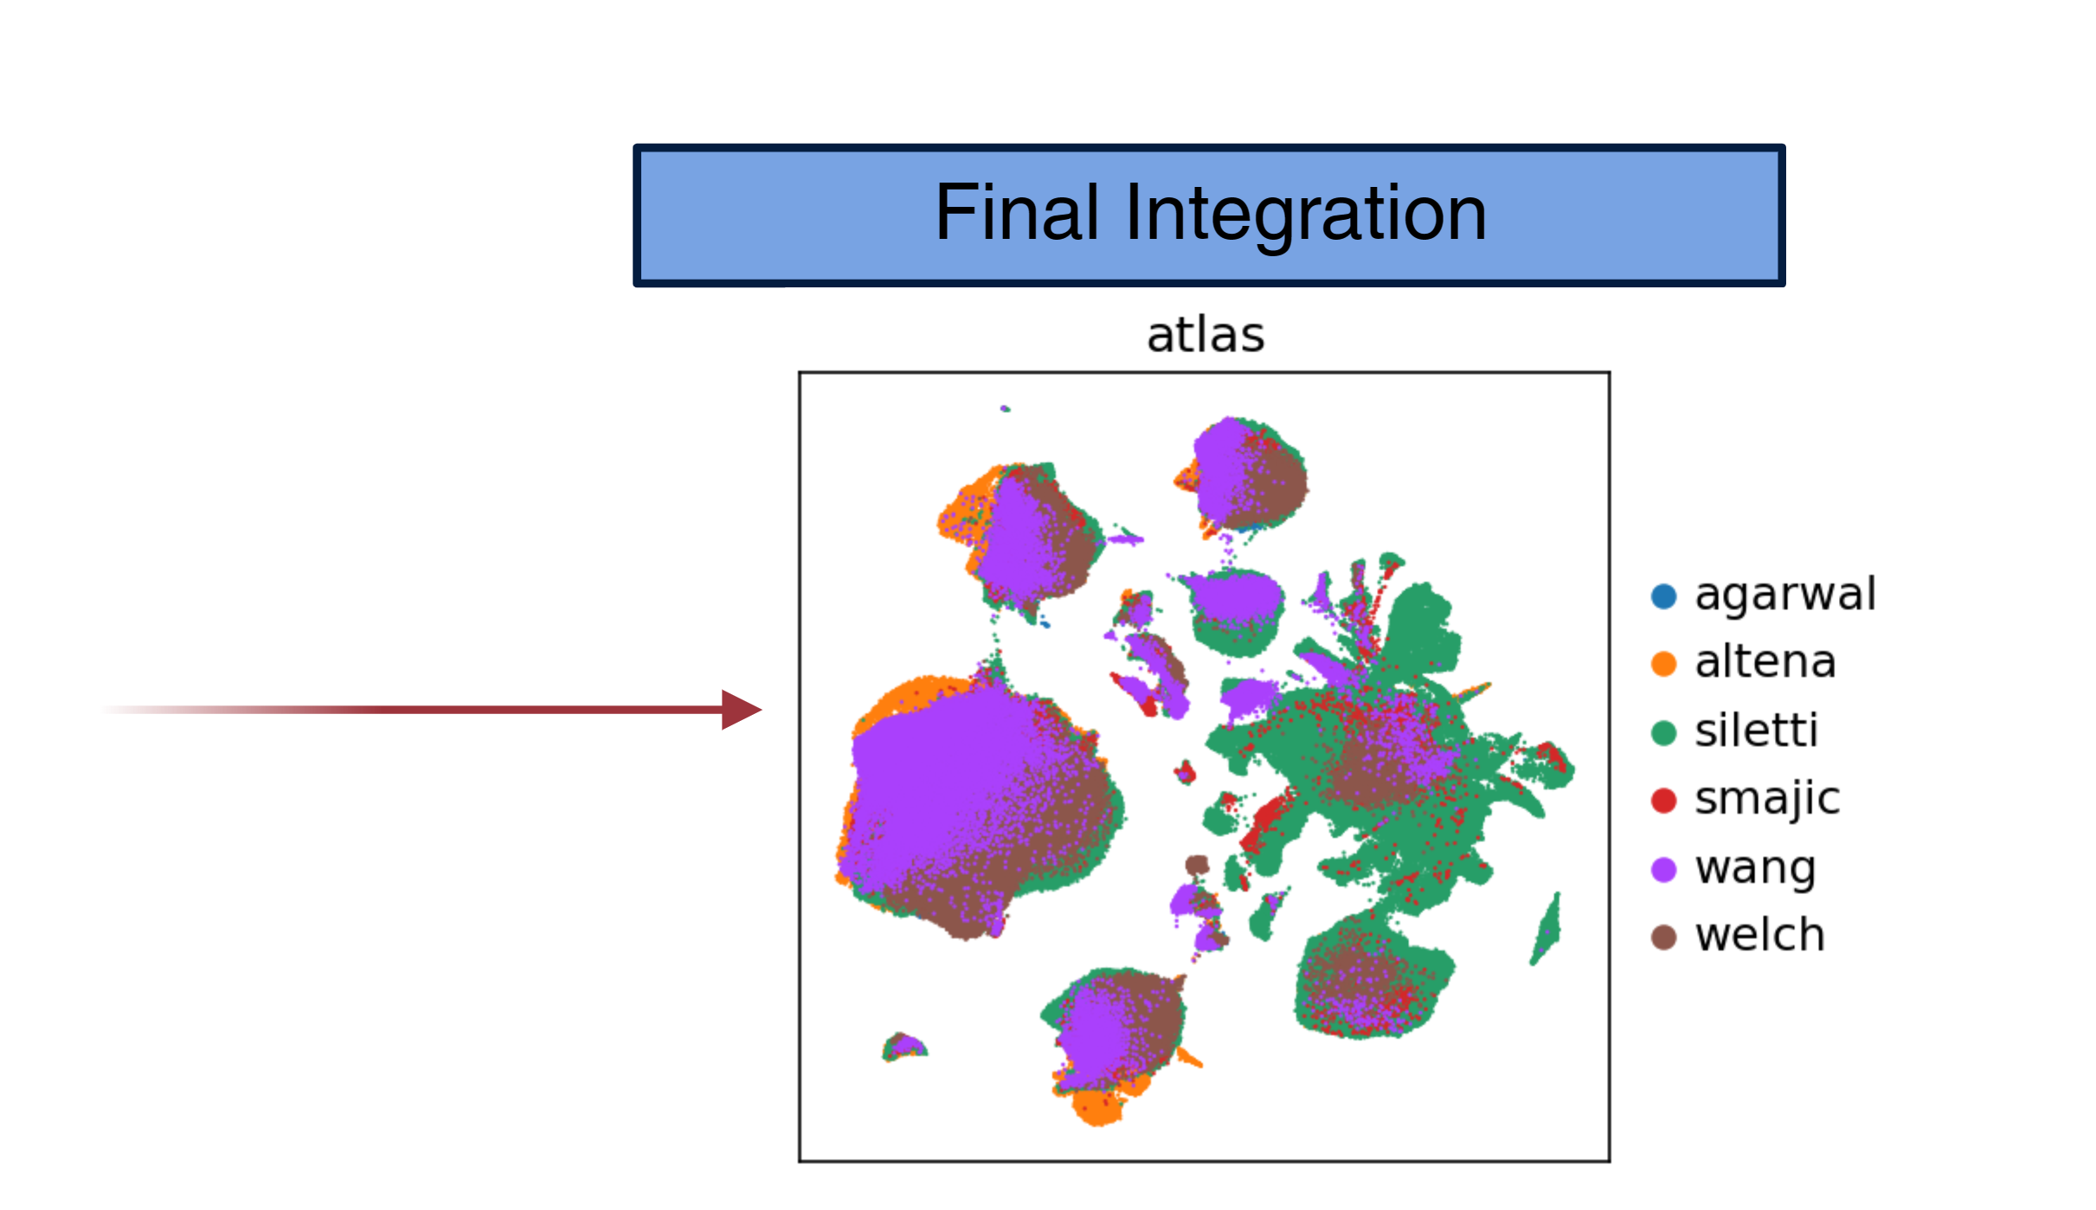
3. Final Integration and Analysis

Slide 36
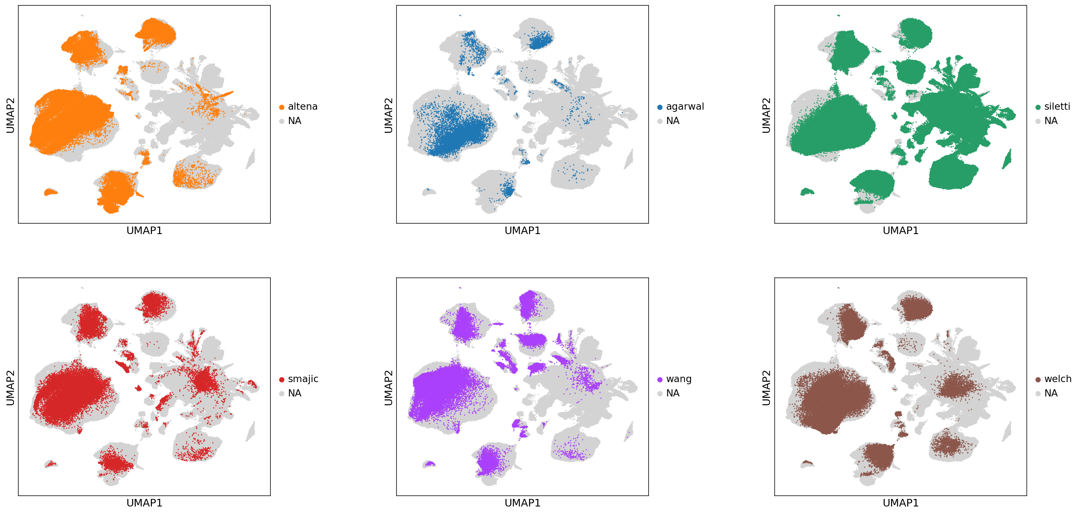
3.1 Final integration (Aim#1)
Hyperparameter values:
2000 HVGs
90 Latent features
5 Hidden layers
128 Hidden nodes

Slide 37
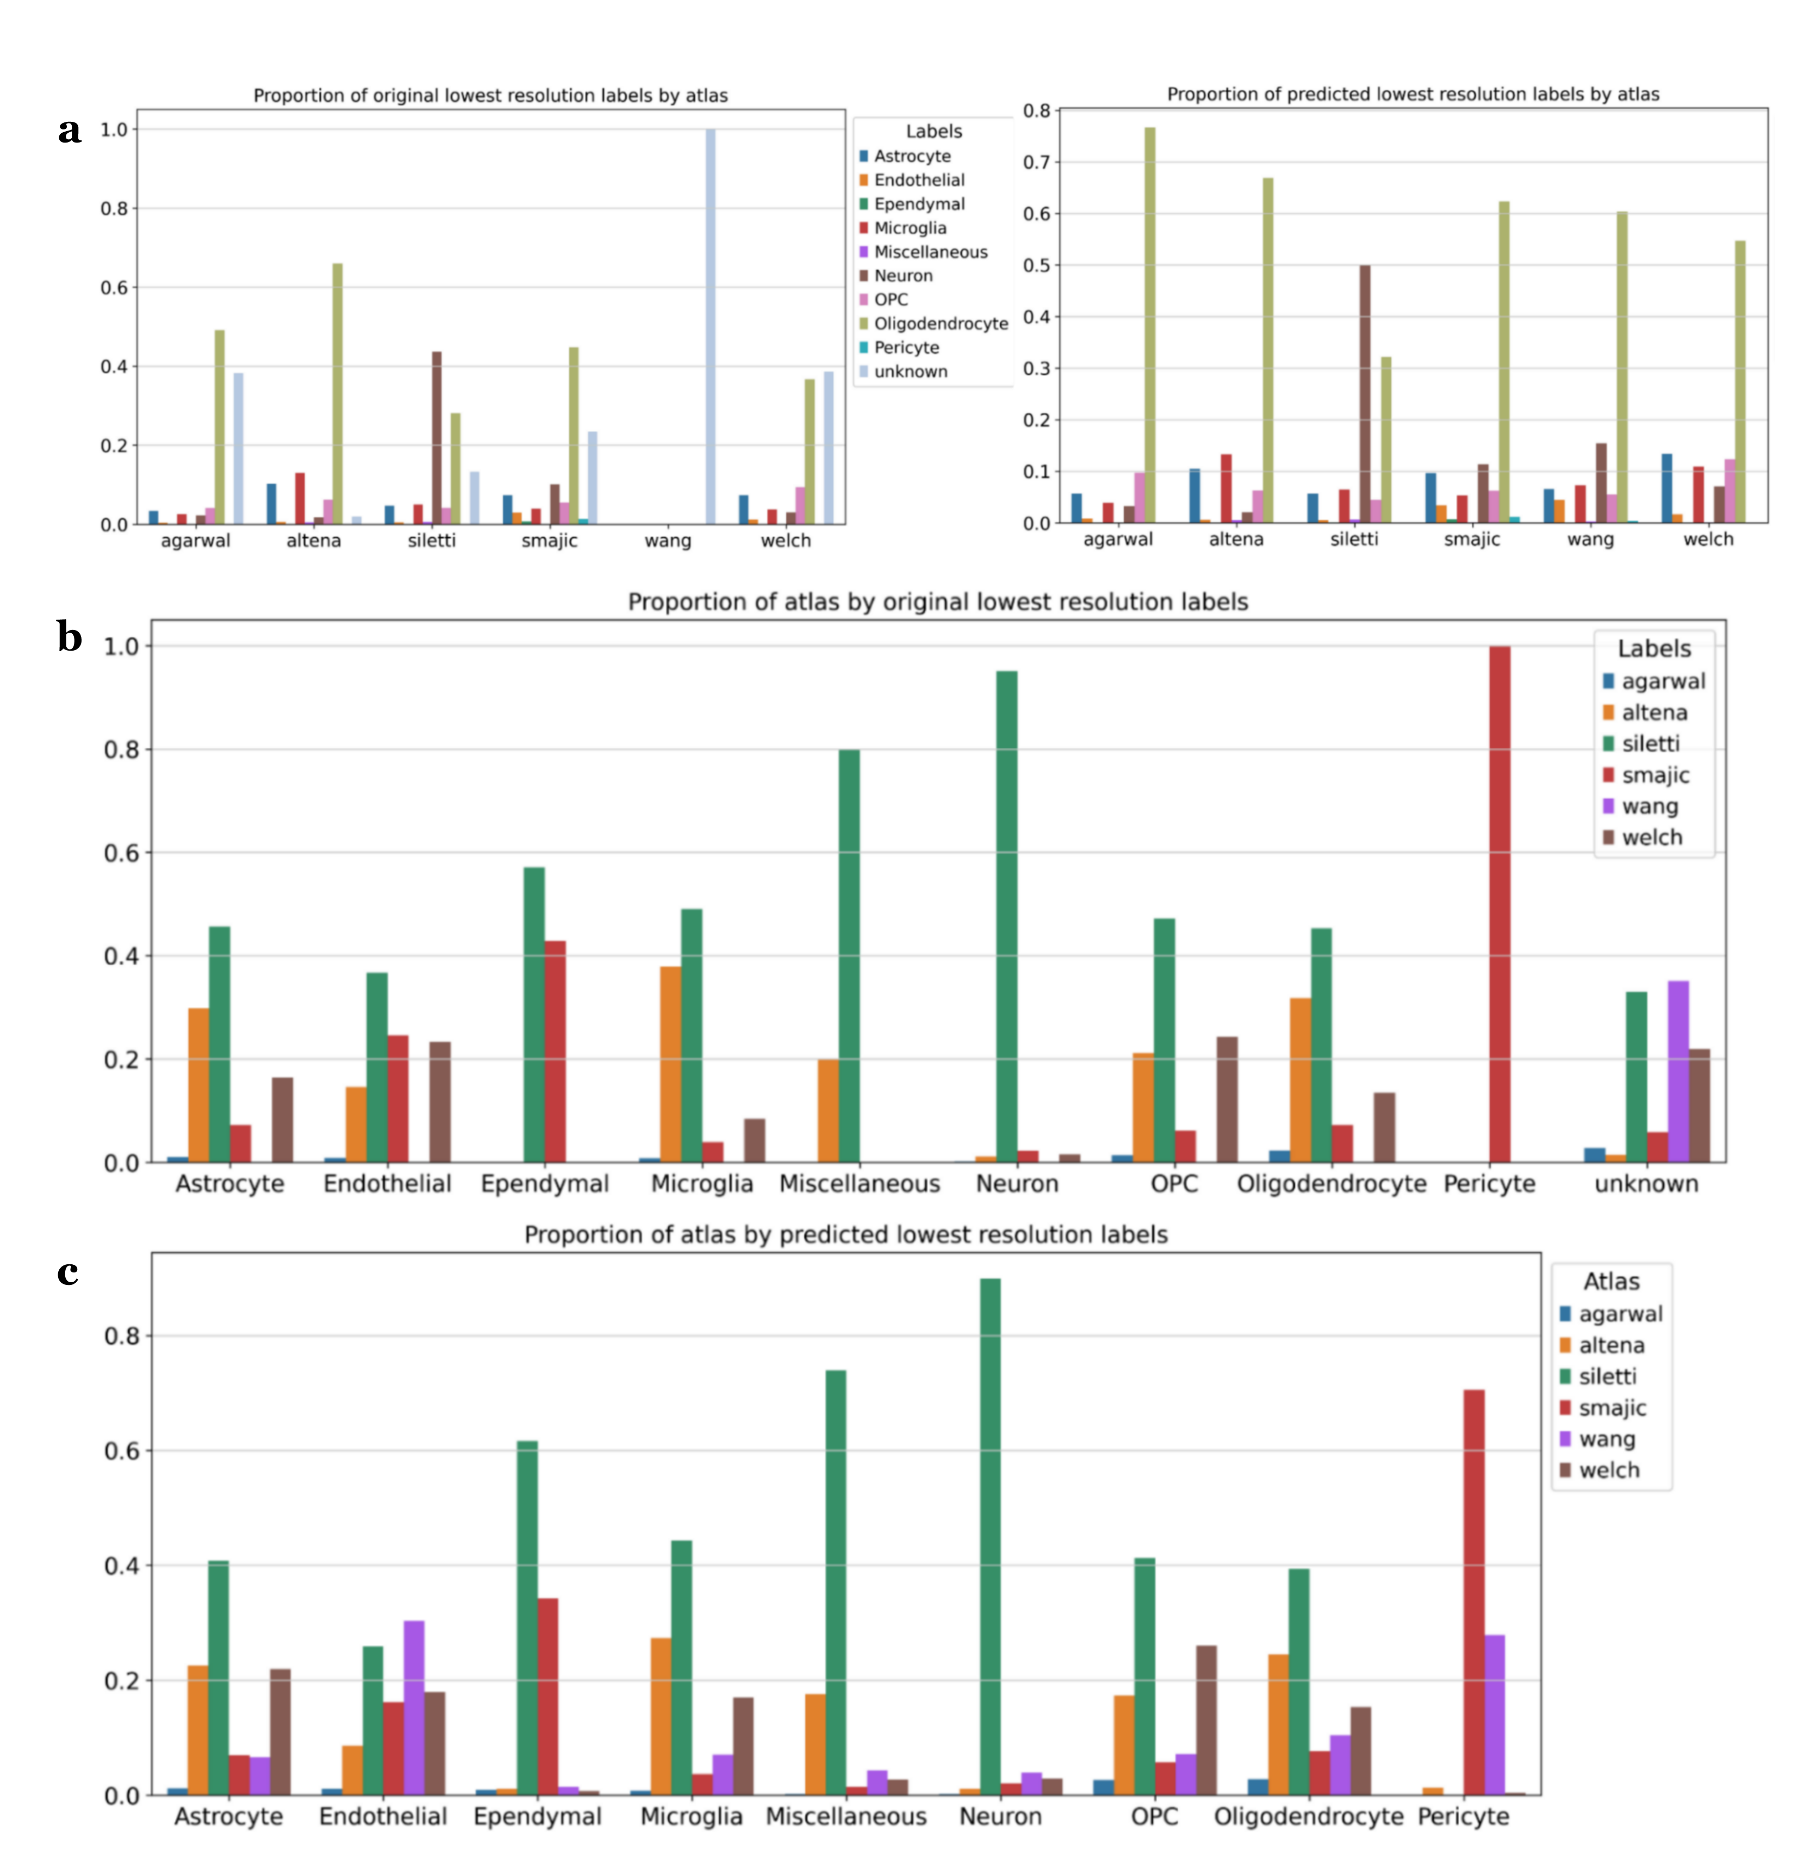
Proportions

Slide 38
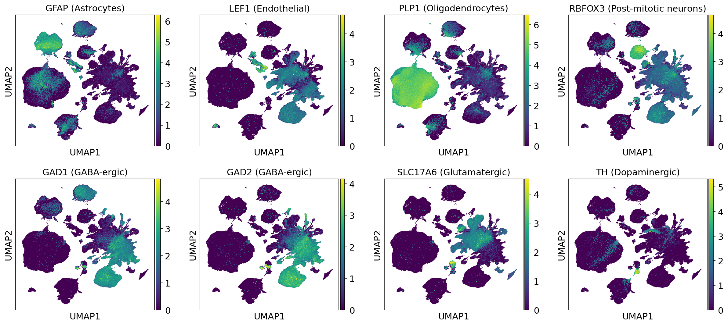
Final integration markers

Slide 39
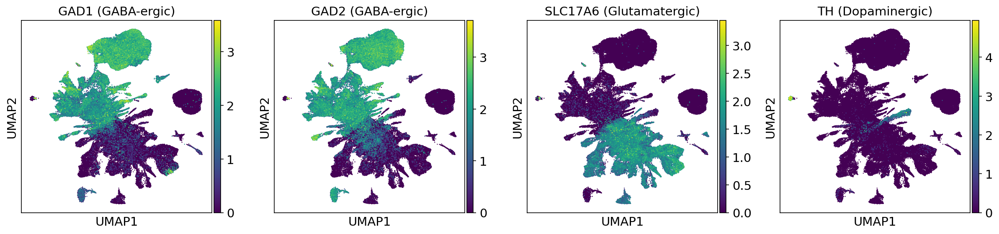
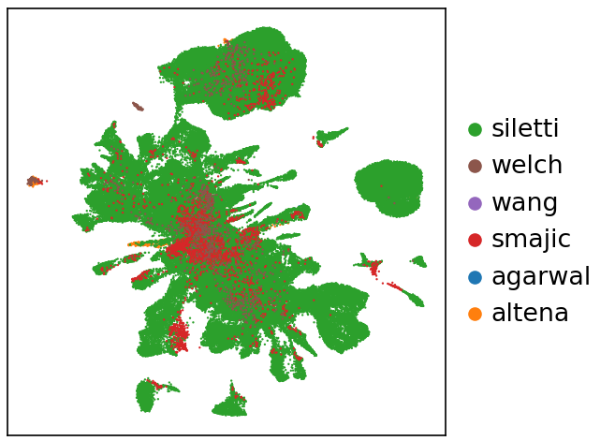
Neuron only integration

Slide 40
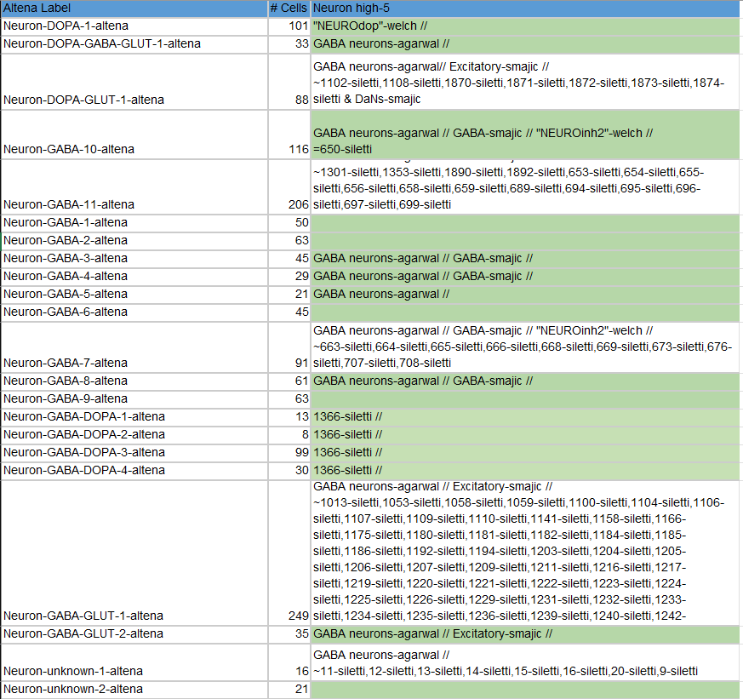
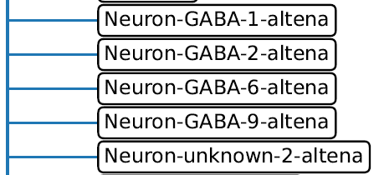
3.2 Neuron Hierarchy using scHPL (Aim#2)
VTA-specific subtypes (van Regteren Altena)
Green: Leaf
//: branch path to Altena label
=: identical label
~:sublabels
Root

Slide 41
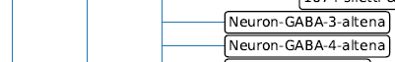
3.2 Neuron Hierarchy using scHPL (Aim#2)
VTA-specific subtypes (van Regteren Altena)
Green: Leaf
//: branch path to Altena label
=: identical label
~:sublabels
Root
GABA-smajic
GABA-neuron-agarwal

Slide 42
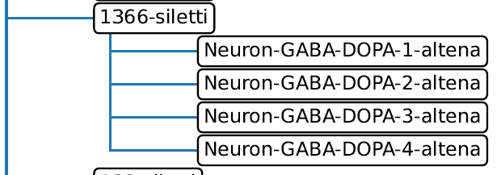
3.2 Neuron Hierarchy using scHPL (Aim#2)
VTA-specific subtypes (van Regteren Altena)
Green: Leaf
//: branch path to Altena label
=: identical label
~:sublabels
Root

Slide 43
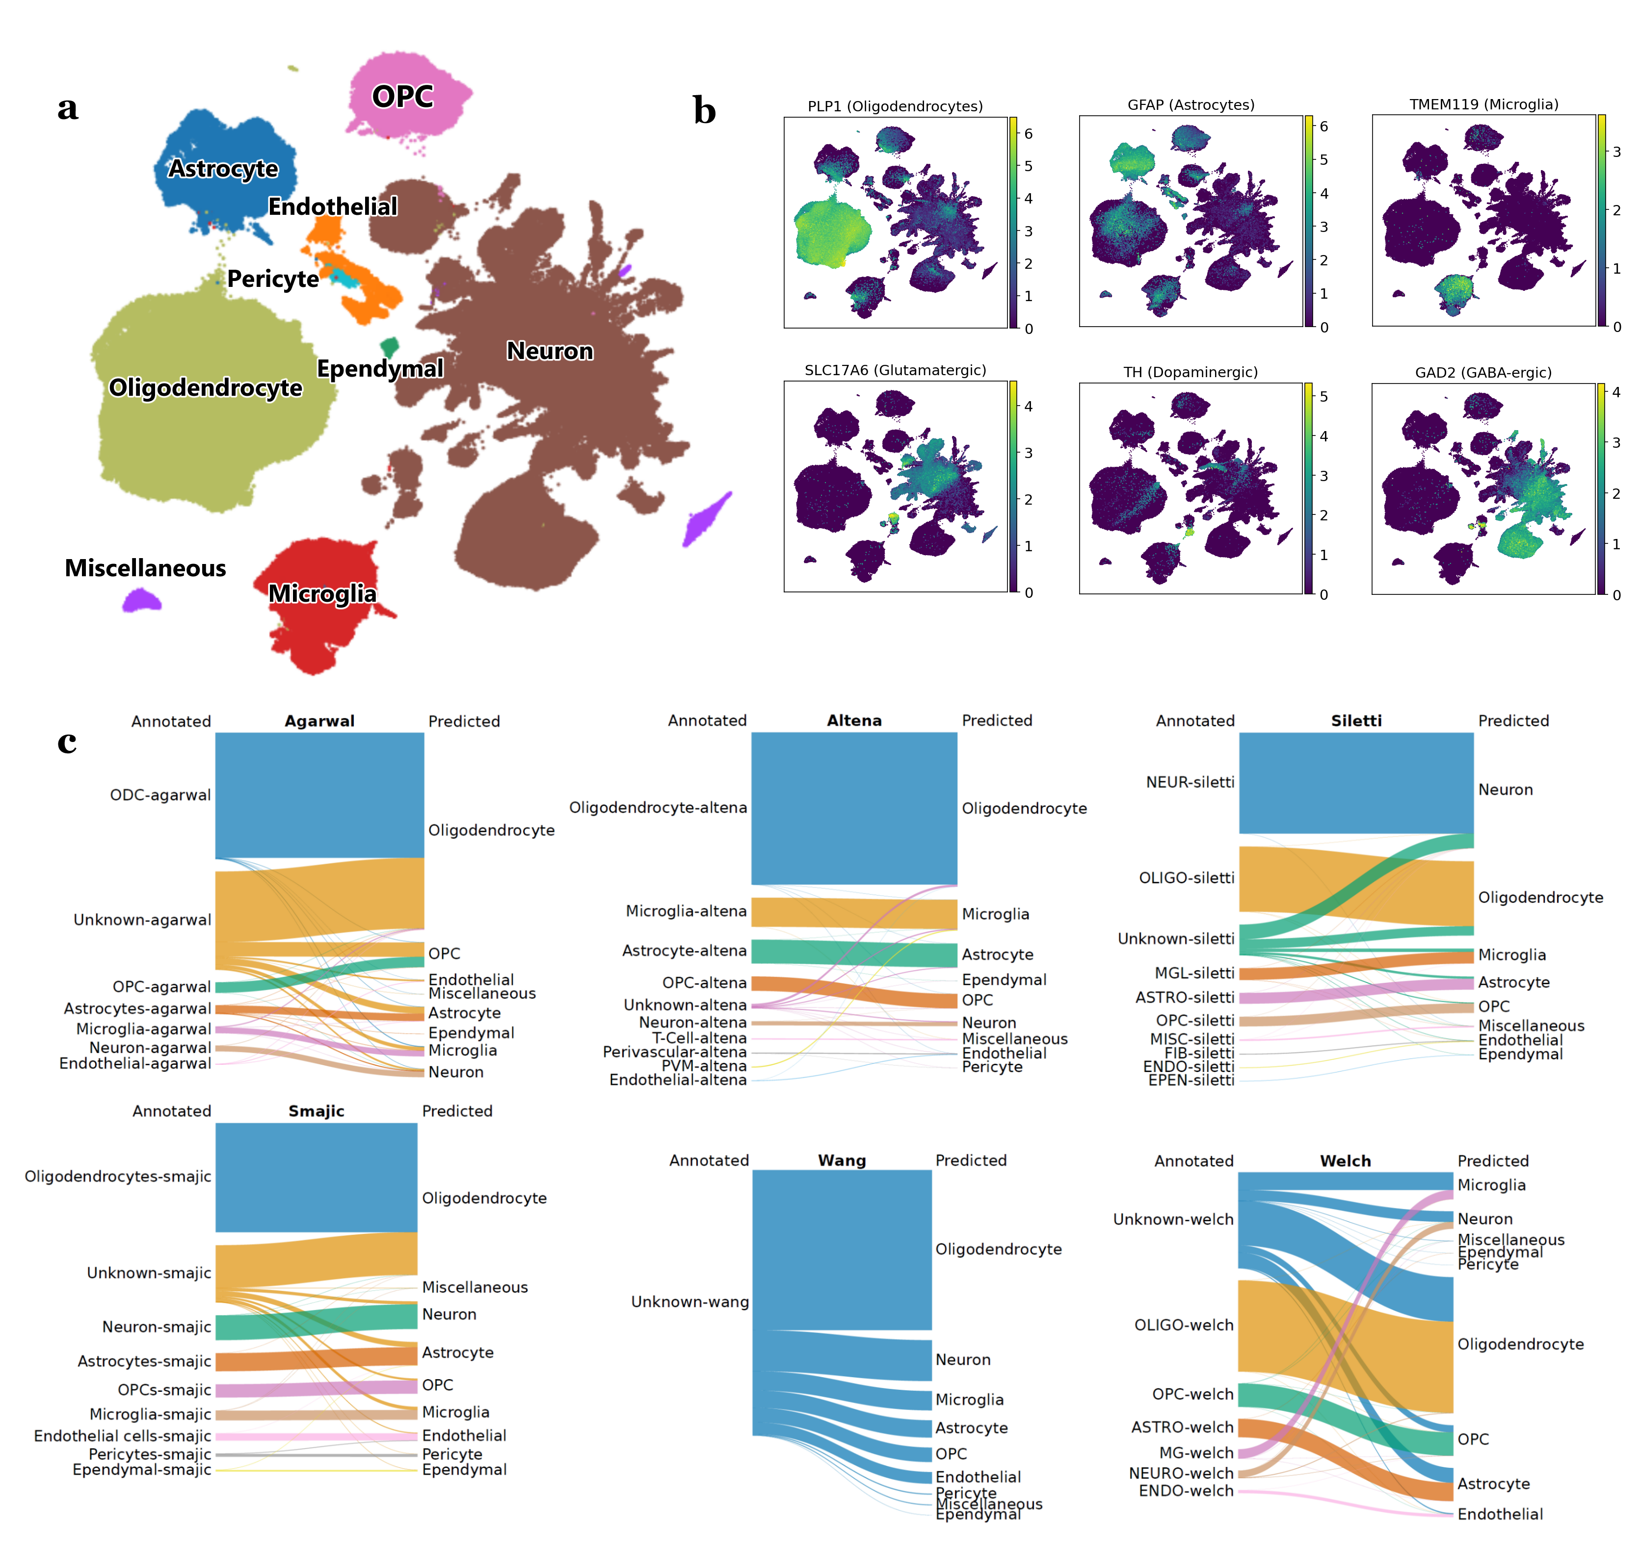
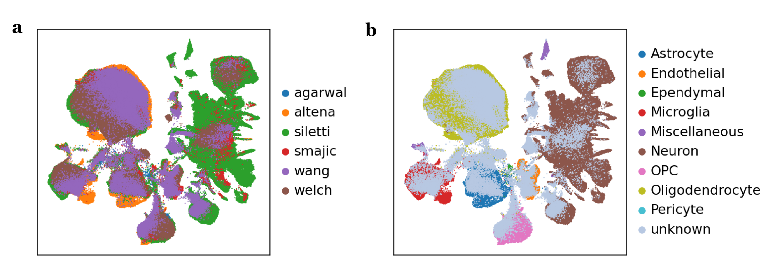
3.3 New cells (Aim#3)
Use harmonized labels to train K-NN classifier
Including a threshold of 0.2 for unknown -> filter out
~520000 -> ~500000 cells

Slide 44
3.3 Reclassification of cells (Aim#3)
Where do these cells come from?
New alignments resulted in more reads
Less filtered cells
Change in transcriptomic profile

Slide 45
3.3 Reclassification of cells (Aim#3)

Slide 46
!
Conclusions
We provide the largest human midbrain reference atlas including a VTA-sampled dataset
Harmonized alignments reduce batch effects in downstream analysis
Realignment of older datasets can provide new data
Region-sampled atlases contribute significantly to characterizing undersampled and region specific-subtypes
Results support the presence of VTA-specific subtypes, but further validation is required

Slide 47
?
4. What’s next?
Continuous learning: Kamath et al. (2022) data access adds 184673 SNpc cells (~15684 healthy dopaminergic cells)
Pipeline can be used for the integration of other regions/ species datasets e.g. mouse (Onur Basak)
Inter-species comparison study of the midbrain (Onur Basak)
Reclustering of reference genome/ neuron subset (Anna van Regteren Altena)
Further characterization of subtypes e.g. spatial information
Looked at neurons, but what about astrocytes, oligodendrocytes etc.

Slide 48
Acknowledgements
Basak Lab
Onur Basak
Tiziana Hey
Abdool Al-Khaledi
Cecile Herbermann
Hol Lab
Anna van Regteren Altena
Others
Kimberly Siletti

